Slide 1
Option Basics

Slide 2
Course Objective
To understand options : pricing, risk, and returns (review)
To use option as reliable strategies for hedging, income generating, and betting on and against volatility
To add options as part of your active trading strategies
To add options as a powerful tool for your swing and longer-term strategies

Slide 3
Course Outline
Option Basics
Class 1
Using Options for Income Generation
Class 2
Class 3
Using Options as a Hedging Strategy
Using Options for Directional Bets
Class 4
Using Options for Range Bets
Class 5
Using Options for Day Trading
Class 6
Option Psychology and Idea Generation
Class 7

Slide 4



What is Included in This Course
Classes with examples and explanation
Summary of all strategies with examples and pros and cons
Complete xls file to calculate implied volatility, and probability lab

Slide 5
Why Options?
Useful strategy for any cycle of the market
Price
Distribution Phase
Market Up Phase
IPO Price: $30
Market Down Phase
Bull Call Spread
Accumulation Phase
Bullish Risk Reversal
Bear Call Spread
Put
Short Straddle
Long Call Butterfly
Long Call Condor
Time

Slide 6
Cutting Through Noise
Over 60 strategies: not all of them are useful! You must define your goals and act after!
Bull Butterfly Spread
Albatross Spread
Bull Condor Spread
Bear Put Spread
Protective puts
Call Ratio Spread
Reverse Iron Butterfly Spread
Bull Albatross Spread
Bear Call Spread
Bear Butterfly Spread
Reverse Iron Albatross Spread
Bull Call Spread
Short straddle
Bull Butterfly Spread
Risk reversals
Bull Call Ladder Spread
Bear Put Ladder Spread
Bear Ratio Spread
Iron Condor Spread
Iron Albatross Spread
Calendar Straddle
Short Gut
Strip Strangle
Covered calls
Short Bear Ratio Spread
Reverse Iron Albatross Spread
Call Ratio Backspread

Slide 7

Way of Thinking Rather than Strategy
Income
Hedge
Direction
Range

Slide 8
Why is it important?
Limited downside
$Cost efficiency
Magnified returns

Slide 9
Understanding Option Pricing
Price of an option is by product of two aspects
Intrinsic Value
Extrinsic Value*
Option strike price – underlying asset price
Volatility Time Borrowing rate
*Greeks: Used in Black Scholes Model

Slide 10
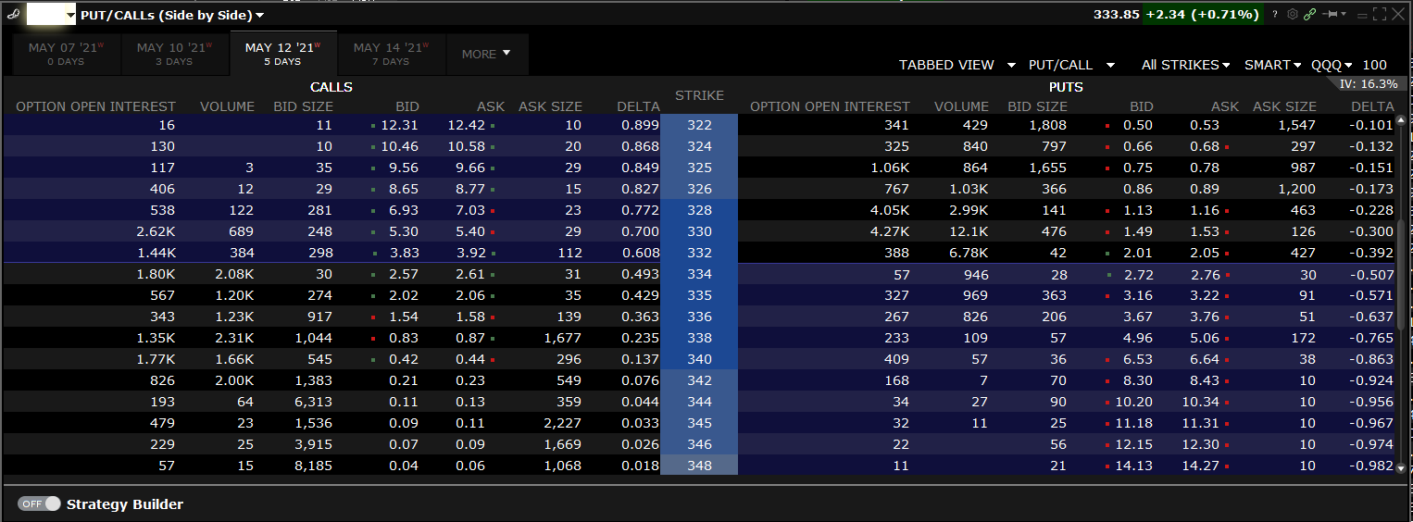
Option Pricing: Example
Let’s look at some real-life examples:
Current Price
Price of the option: $12.42
Intrinsic Value:
$322 -333.85= $11.85
Extrinsic Value
$0.57
Way out of the money: no intrinsic value = $0.00
Extrinsic value: $0.06

Slide 11
Extrinsic Value: Greeks
Delta (∆)
Change in the price of option for every dollar move in the underlying asset: Way to think of it: probability of the option ending In The Money (ITM)
Gamma (γ)
Rate of change of Delta: It is the highest when the option is ATM and near Expiration (mostly useful for market makers of the option)
Theta (θ)
Rate of Time Decay
Vega (ν)
Measure of Implied Volatility and uncertainty

Slide 12


Two Way to Use Options
Net Seller of Options
Time works in your favor
Investment banks and S&Ts
Higher probability
Net Buyer of Options
Time is your enemy
Higher upside
Lower probability trades

Slide 13
Key Things to Remember
Call seller has the obligation to sell the stock at the strike price in expiry
Call buyer has the option to buy the stock at strike in expiry
Put seller has the obligation to buy the stock at the strike price
Put buyer has the option to sell the stock at strike price

Slide 14
Option Expiry and Settlement
Third Friday of each month
Every Friday for more active stocks
Monday Wednesday and Friday for indexes!
They are AM and PM settlements, but mostly PM!
XSP (1/10th of the size of the S&P500) and MRUT (1/10th of the Russell 2000 index) : European Style
Options could be settled in cash (the difference) or the actual shares of underlying stock
Options could be European (only exercised at expiry), or American (exercised any time when in the money)
Beware of American style expiry for dividend stocks going ex-dividend
Details on this can be found in the accompanied pdf and the xls file

Slide 15
Time Decay
Time premium
in an option
As a buyer of the option, time is working against you. And the speed is accelerating
As a seller of the option, time is working for you.
Time

Slide 16
VIX and Options
S&P monthly implied volatility (fear gage)
VIX can be calculated using the xls file we provided in the course or to be cross checked with the quoted VIX
VIX is the 30day implied volatility for S&P and can be a good gage for future volatility expectations
VIX should solely be used as a temperature check on future volatility expectations
Seller of the options
buyer of the options

Slide 17
Payout Diagram
Major payout diagram: combining these can create anything
Long Stock
Short Stock
Long Bond
Short Bond
P
P
P
P

Slide 18
Payout Diagram
Major payout diagram: combining these can create anything
Buy Calls
Sell Calls
Buy Puts
Sell Puts
P
P
P
P

Slide 19
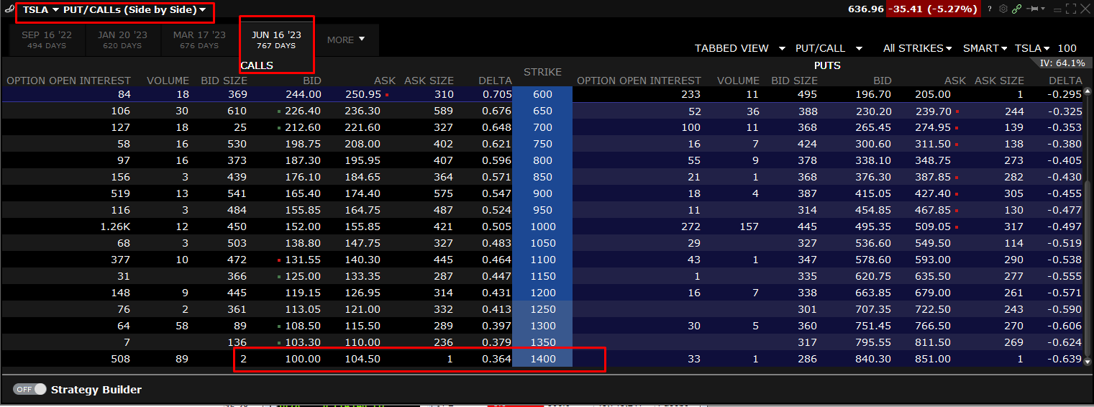
Liquidity
It is important to understand that option market is not liquid by nature
When choosing the strategy: pay attention to bid and ask spread
The longer the duration of the option, the bigger the bid and ask spread (Not always, depends on demand more than DTE)
+700 days
You lose $450 just to bid and ask spread!

Slide 20
Option Open Interest and Volume
Volume and open interest are two key technical metrics that describe the liquidity and activity of options and future contracts
Volume is an important measure of strength and interest in a particular trade.
The volume and open interest metrics provide information about the level of buying and selling underlying a potential price move.
Volume reflects a running total throughout the trading day and open interest is updated just once per day
Volume
Open Interest
Number of contracts traded in a given period
Number of contracts that are active or not settled

Slide 21
Their Impact on Volatility
A rise in the option price without a corresponding rise in the stock price results in an increase in an option contract's implied volatility.
When the volume exceeds the existing open interest on a given day, it suggests that trading in that option was exceptionally high that day.
Open interest also gives you key information regarding the liquidity of an option.
When analyzing changes in option volume, volatility, and volatility skew, it is important to consider changes in open interest.
A large volume on option contracts does not necessarily mean there is an increase in interest regarding a stock. If fact, it may mean quite the opposite.

Slide 22
What is Volatility
Implied Volatility
Realized volatility
Volatility

Slide 23

Understanding Volatility
You have two options: choosing $200 or choosing $150 with 50% probability or $300 with 50% probability
If you are a risk neutral individual, which we assume most traders are, you should choose option 2.
Option 1: $200 option 2: $150+ $75 = $225

Slide 24


Understanding Volatility
Now imagine the following scenario:
Option A: $30 guaranteed Option B: $90 with 25% probability or $10 with 75 probability?
You have two outcomes: both pay out are the same
So should a risk neutral individual be indifferent? Wrong!
Here is where volatility comes into play?
Option A
Option B
$30
$90
$10

Slide 25
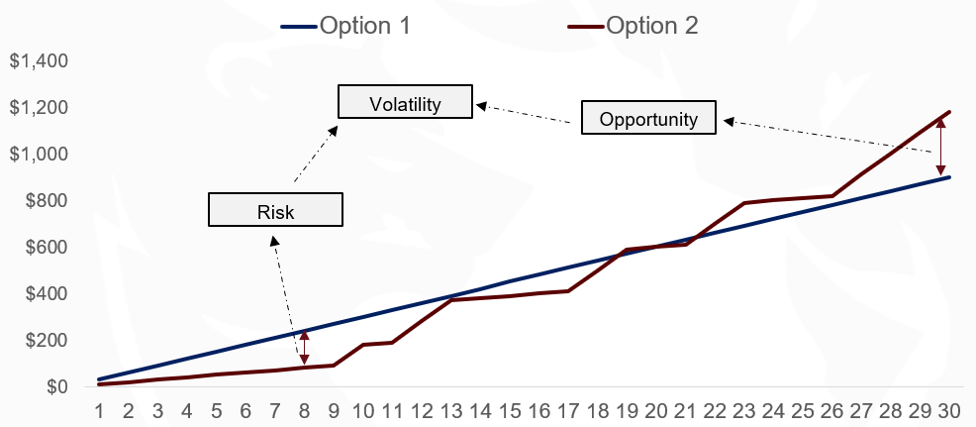
Understanding Volatility
Random draw shows the following result after 30 times play: as you can see while expected pay off was the same, the outcome is different.

Slide 26
Market Makers of the Option
When you use options most often than not you are betting on direction of stock, using option for additional leverage or to limit your downside.
In contrast Market Makers are betting on the Realized volatility of a stock over a specified time period until the contract expires
Market makers trade the underlying stock to hedge their delta

