Slide 1
Income Generating Strategies

Slide 2
Course Objective
To understand options : pricing, risk, and returns (review)
To use option as reliable strategies for hedging, income generating and bets on or against volatility
To add options as part of your active trading strategies
To add options as a powerful tool for your swing and longer-term strategies

Slide 3
Course Outline
Option Basics
Class 1
Using Options for Income Generation
Class 2
Class 3
Using Options as a Hedging Strategy
Using Options for Directional Bets
Class 4
Using Options for Range Bets
Class 5
Using Options for Day Trading
Class 6
Option Psychology and Idea Generation
Class 7

Slide 4
Sellers of Options
Based on a CME study, 75% of option contracts expired worthless.
Over 70% of options expiring worthless

Slide 5
Two Main Ways of Generating Income
Two main strategies that are used to generate income in your portfolio:
Selling calls
Selling puts

Slide 6
Selling Calls
Selling calls can be a great strategy to generate income for your portfolio
Covered calls or naked calls
Selling covered call is like renting your house for some rental income
It can also reduce your Avg price, if you are in a losing position!
Payoff
Best Case: you collect the premium
Price
Loss could be unlimited if sold naked
Worst Case: Participate in a dollar-for-dollar loss above the strike price

Slide 7
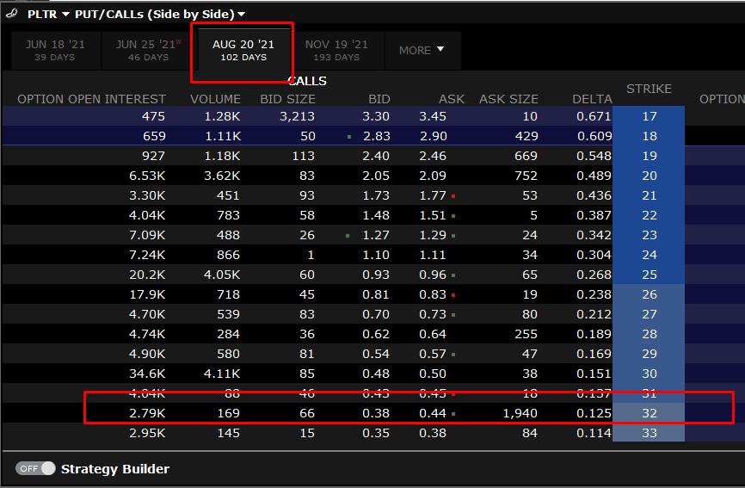

Example: Covered Calls - Long Term
You have 200 shares of PLTR and are hoping to keep long term: 1 - 2 years
Average price is $23
Your Hurdle Rate is 40% - i.e. you would sell at $32 per share
You sell 2 covered calls, strike price at $32 and collect $76 in premium
Rate of Return (RoR): $\frac{\$76}{\$6400}=1.2\%$
Annualized RoR of 4.361% - higher than dividend yield of many deep value stocks

Slide 8
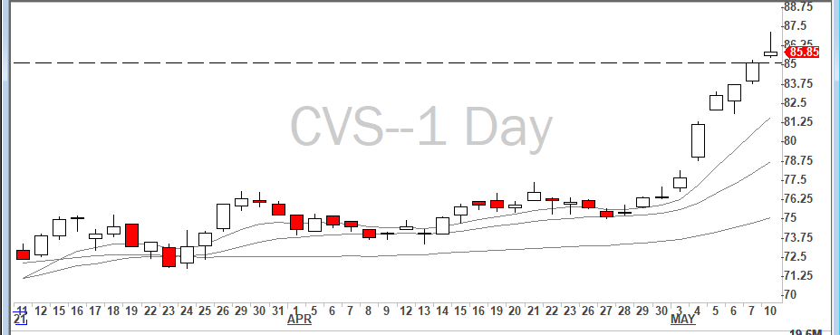
Covered Calls Strategy
You could use covered calls for aggressive growth stocks which you are intending to keep for a longer term
You could use them after earnings for stocks which has already ran up
You could use technical or fundamental
How you produce the strategy is not as important as your risk to reward and annualized rate of return
I personally do not engage in anything lower than 2% annualized yields
Rule of thumb: You want to sell covered calls for stocks that are over extended
Divergence from moving averages

Slide 9
Time Decay and Selling Calls
Time Decay slopes get steeper as we move forward in time
For this reason, many traders use shorter time frames to write calls, 3 weeks maximum.
You get most of the time decay benefit in the last few days of the option life
Time premium
in an option
Time

Slide 10
Selling Naked Calls
I personally do not like selling naked calls
The risk to reward do not make any sense
An upside call generally has much lower implied volatility than downside puts: hence your premium you collect is too little in comparison to the risk you are accruing!
As a rule of thumb, you want to avoid strategies that have limited upside and unlimited downside
Standard deviation of historical data is meaningless! You have to look at implied volatility, consider your unsystematic risk and systematic risk caused by the market in general
Realize you can not trade options after hours and on weekend. If the stock gap up or gap down, a lot could go wrong!

Slide 11
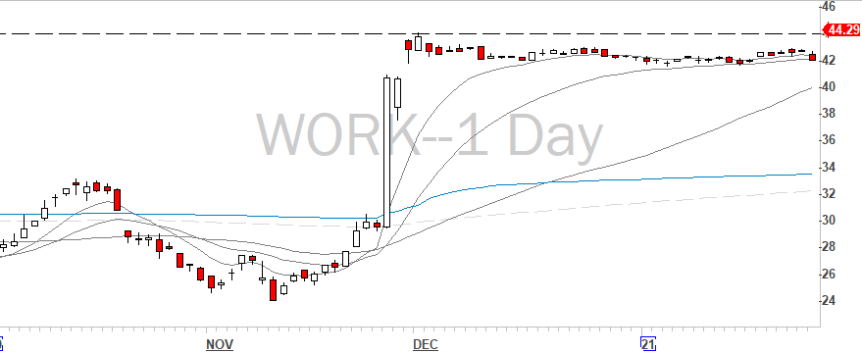
M&A take over? Real Example
You have written naked calls on Slack $WORK strike at $32 2 standard deviation away: collect $130 ($1.30 for option contract) in premium
News comes out: Sales force is going to acquire Slack for $42 a share, all cash deal. Stock gaps up
Your call are now trading at $13.50
You end up loosing over 1k just to collect $130 This is what many call the “Gap Up risk”

Slide 12
Selling Puts
This strategy is targeted buy i.e. putting a limit-buy order, but you are getting paid for it
This is perfect strategy in case you are looking to add a security at a certain price
Could be used speculatively for potential reversals
Better cost average for stocks as you get exactly the price you want, if you get assigned
P&L
Best case scenario: collect all the premium
P
Participate in every dollar for losses after the strike price

Slide 13
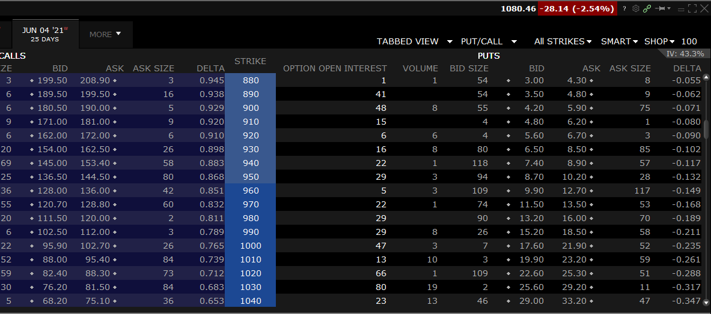

Example: Targeted Puts
I want to add $SHOP to my portfolio, but only at or below $900
I could put a limit buy order at $900, or sell puts at $900
You sell the $900 Strike Puts and collect $420 in premium. Option expires in 25 days.
Rate of Return (RoR): $\frac{\$420}{\$90,000}=0.5\%$
Annualized RoR of 7.6% - higher than dividend yield of many deep value stocks

Slide 14
Targeted Puts Strategy
Mostly used for reversals, for the stocks that have been sold off heavily and expected to make a reversal (swing or day trading)
Could be used to buy a stock at a desired price (longer term)
Fantastic way to generate income for portfolio that is aggressive growth
How you produce the strategy is not as important as your risk to reward and annualized rate of return
I personally do not engage in anything lower than 2% annualized yields
Rule of thumb: You want to sell puts for stocks that are over sold

Slide 15
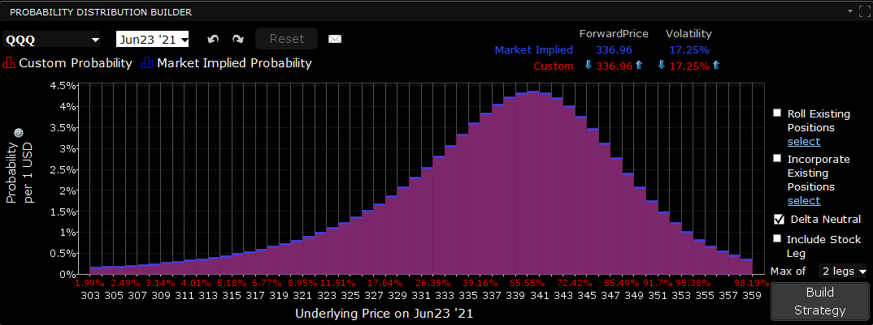
A Cautionary Tale
These are not strategies be solely used! They should be used as part of an ecosystem of strategies
You can not make a living solely off selling options! The return is just not large enough to make that happen
Understand that normal distribution of a stock is based on the historical volatility. Just because you sell an option 2SD away, that does not mean you have 95% profit probability
Understand your notional exposure!!!!
You do not want take a lot of risk, for tiny amount of profit
Selling the OTM put or OTM call is not a free licenses to print money

Slide 16
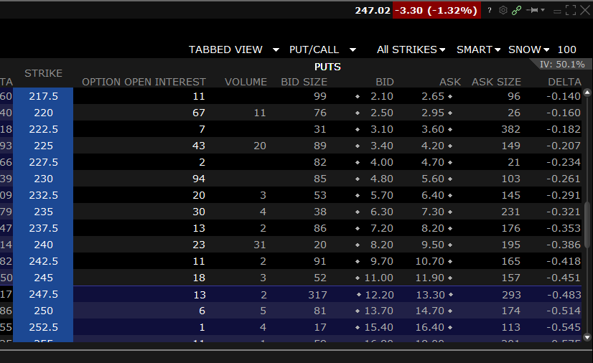
Understanding Notional Exposure
I personally do not recommend engaging in naked calls or puts
The notional exposure is just not worth the reward!
$Snow currently trading at $247 option chain for 30 days out.
Your notional exposure is $24,000 for $820 reward!

Slide 17
Conclusion: Let the Time Work for You
Pick stocks with higher implied volatility
Something you would want to own
Bigger premium
As a buyer of the option, time is working against you. And the speed is accelerating
Time premium
in an option
As a seller of the option, time is working for you.
Time

