Slide 1
Using Options as a Hedging Strategy

Slide 2
Course Objective
To understand options : pricing, risk, and returns (review)
To use options as reliable strategies for hedging, income generating and bets on or against volatility
To add options as part of your active trading strategies
To add options as a powerful tool for your swing and longer-term strategies

Slide 3
Course Outline
Option Basics
Class 1
Using Options for Income Generation
Class 2
Class 3
Using Options as a Hedging Strategy
Using Options for Directional Bets
Class 4
Using Options for Range Bets
Class 5
Using Options for Day Trading
Class 6
Option Psychology and Idea Generation
Class 7

Slide 4
Hedging
Protective Puts
Covered Calls for Ex Dividend stock
Hedging
Covered Call Collar
Delta Hedging

Slide 5
Delta Hedging
Delta hedging is an option strategy that aims to reduce directional risk
It is widely used before earnings to limit any extreme movements downsides
The goal is to reach a Delta Neutral stage

Slide 6
Delta Hedging
Price of your stock
Price of your put option contract
Neutrally Hedged position

Slide 7
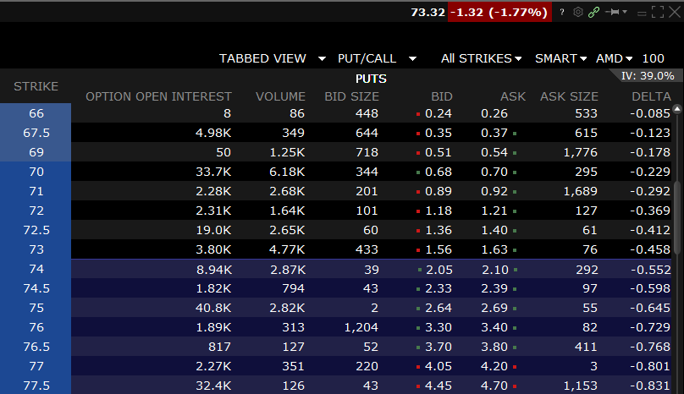
Example: Delta Hedging
You have 100 shares of $AMD currently trading at $74. You are looking to hedge your position in case of a bad earning
Since you have 100 shares, your positions delta is 100∆
You look at the option chain to find the right puts to make the ∆ equal or close to zero
$73 puts have the delta of -0.458: to reach neutrality we need 1/0.458= 2.1
Two contracts of this option would help us reach neutrality
This Neutrality is costing you $326 ($163*2)

Slide 8
Delta Hedging Payout Diagram
Long stock
Long put
Results
P&L
P&L
P&L
$71.40
$73
P
$76
P
$73
P
Premium spent
Limited downside

Slide 9
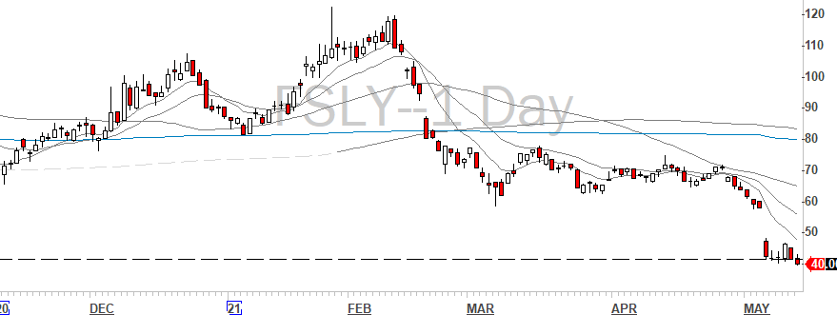
Delta Hedging: Real Example
We owned $FSLY in the fund
Wanted to hedge our downside before the earnings
Delta Hedging saved us from a
30% drop

Slide 10
Covered Call Collar
This is strategy where you sell a covered call, and with the proceed, buy OTM puts: Net Credit strategy
You are being paid to protect your profits from downside
P&L
Long put
Short call
Long Stock
Covered call collar
Price

Slide 11
Covered Call: Ex Dividend Hedge
As an owner of a stock that pays dividend, you are entitled to the payment, up until the ex-dividend date!
Ex-dividend is when a stock trades without the value of the next dividend
As an example: Below is the Apple’s dividend schedule
Ex-dividend date | Amount | Pay Date
May 07/2021 | $0.22 | May 13/2021
Feb 05/2021 | $0.20 | Feb 11/2021
May 7th
May 13
Ex dividend could go up or down, but holds often specifically on high yield tickers
No dividend will be paid to owners after May 7th therefore the stock price adjusts
Option prices do not readjust ex dividend, as they are already priced in the dividend impact
This strategy is often called dividend protection strategy
You get to collect the premium while the stock adjust to the ex-dividend price

Slide 12
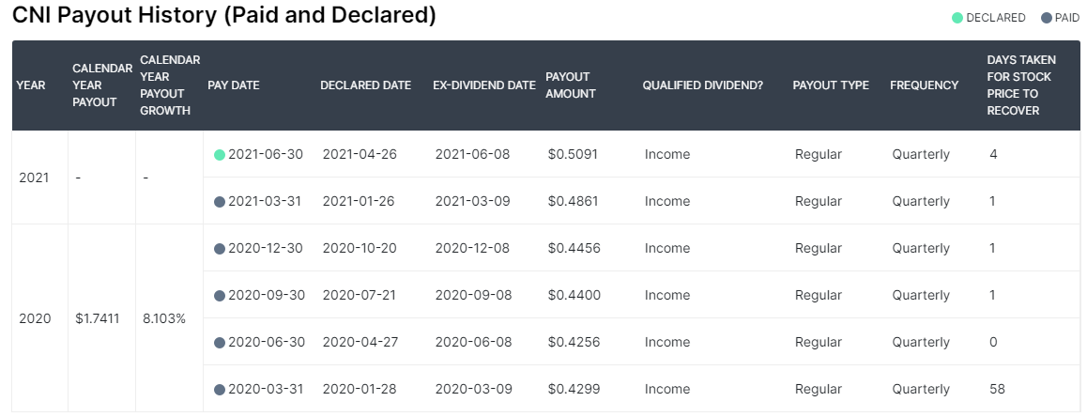
Covered Call: Ex-Dividend
My favorite website to get real, trustworthy data is Dividend.com (https://www.dividend.com/)
You can see when was the ex-dividend date and when is the next dividend declared.

Slide 13
Protective Puts
These are what I call insurance trade, to protect your already big gains
Imagine you have bought 1,000 shares of $QQQ when it was $100
It has had a huge run in a short amount of time, and it is now trading at $335
Unrealized profits are $235,000! Good sum of cash!
You do not want to sell yet, because you want to participate in the upside
How can you protect it?
By buying puts! You buy ATM puts for $10.50 expiry in 60 days.
You do not want to overpay for this insurance, so knowing how to calculate your effective sale price return is the key!

Slide 14
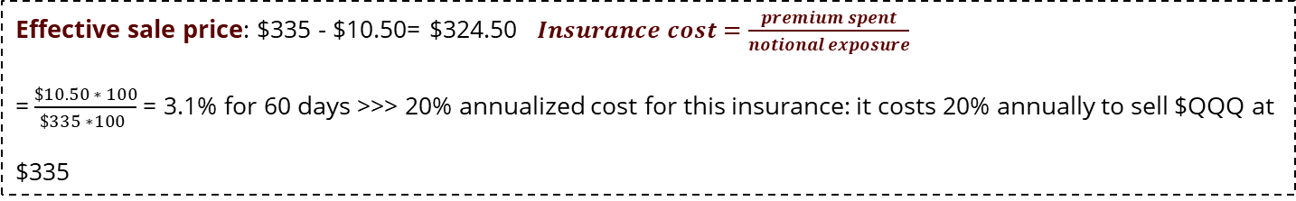
Protective Puts
Price
Price
Buy ATM Puts, for $10.50
$335
$335
$235*1000 =$235,000
$110.50
$100
Insurance cost
$100
Time
Time
Effective sale price: $335 - $10.50= $324.50 $Insurance cost=\frac{premium spent}{notional exposure}$
=$\frac{\$10.50 ∗ 100}{\$335 ∗100 }$ = 3.1% for 60 days >>> 20% annualized cost for this insurance: it costs 20% annually to sell $QQQ at
$335

Slide 15

The Black Swan Event
It is important to know no one knows that when the next black swan event is going to be -or it won’t be called black swan
Your portfolio of $100,000 have returned 20% in the last year: NAV is $120,000
You are worried about a market fall or correction: Sacrifice some of the performance to protect downside
Buying OTM puts on the index that best represent your portfolio
If your portfolio is mostly large cap U.S. name: SPY is your represented index
Frequency
2008 market crash
1987 crash
9/11
U.K. leaving Exchange Rate Mechanism
Algo Flash Crash
Severity/Impact

Slide 16
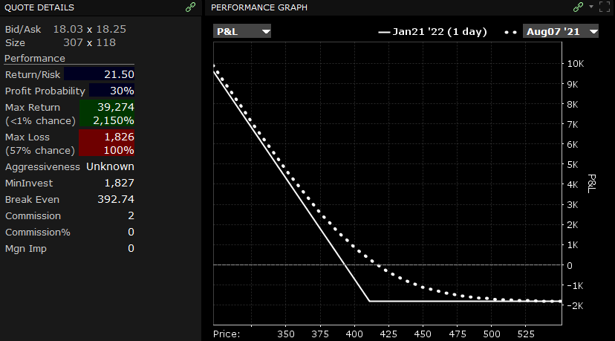
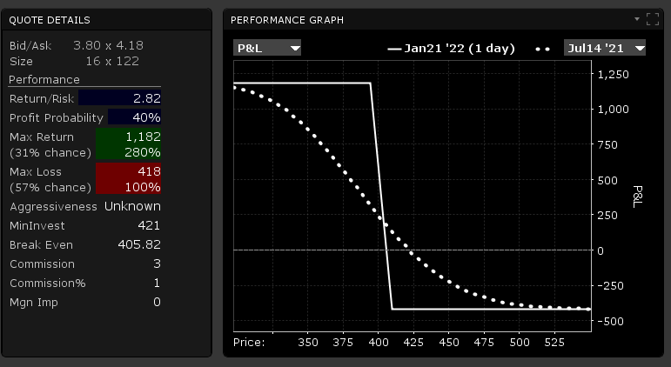
Black Swan: Example
SPY currently trading at $424.28 (June 11th, 2021)
3% draw down: buying 1 Put Contract on $SPY $411 for $18.20 expiry January 2021
Notional exposure: 1 * 100 * 411 = $41,100
Cost: 1 * 100 * $18.30 = $1,830
Your cost is: 9% of your gain
You could alternatively use Put Spreads to reduce the cost

Slide 17

Conclusion
Options can be used as an excellent hedging tool
Two of the most common strategies are the following: delta hedging and protective puts
Consider that time decay is working against you every time you are buying options

