Slide 1
Using Options as a Directional Strategy

Slide 2
Course Outline
Option basics
Class 1
Using options for Income generating strategies
Class 2
Class 3
Using options Option as a hedging strategies
Using options for directional bets
Class 4
Using options for range bets
Class 5
Using options for day trading (by Andrew and Jarad)
Class 6
Option psychology and idea generations
Class 7

Slide 3
Class Objective
To understand options : pricing, risk, and returns (review)
To use option as reliable strategies for making directional bets
To use spreads as a way to reduce your cost of entry
Understanding risks and payout diagrams
To understand Spreads, Straddle, Strangle, and other advanced strategies

Slide 4
Strategies Discussed in this Class
Directional Strategies
Bullish Risk Reversal
Strap and Strip Straddle
Strap and strip Strangle
Bullish and Bearish Spreads

Slide 5
Stock Phases and Options
Stock Price
Distribution Phase
IPO Price: $30
Market Up Phase
Market Down Phase
Bull Call Spread
Accumulation Phase
Bullish Risk Reversal
Bear Call Spread
Put
Short Straddle
Long Call Butterfly
Long Call Condor
Time

Slide 6
Bullish Risk Reversal
When you are looking at a potential reversal on a stock that is oversold: Catalyst could be earnings, or positive news
This is a cheaper alternative to buying the stock, with a similar exposure!
The strategy is simple: Sell one OTM put to fund buying one OTM call for same expiry
This strategy simulates being long on a stock
Payoff
Unlimited upside
Sell Puts
Buy Calls
Stock Price

Slide 7
Understanding Your Risk to Reward
Max loss if net credit | (Put strike - net premium)*100
Max loss if net debit | (Put strike + net premium)*100
Breakeven if net credit | Stock must close above: put strike - net credit
Breakeven if net debit | Stock must close above: call strike + net debit

Slide 8
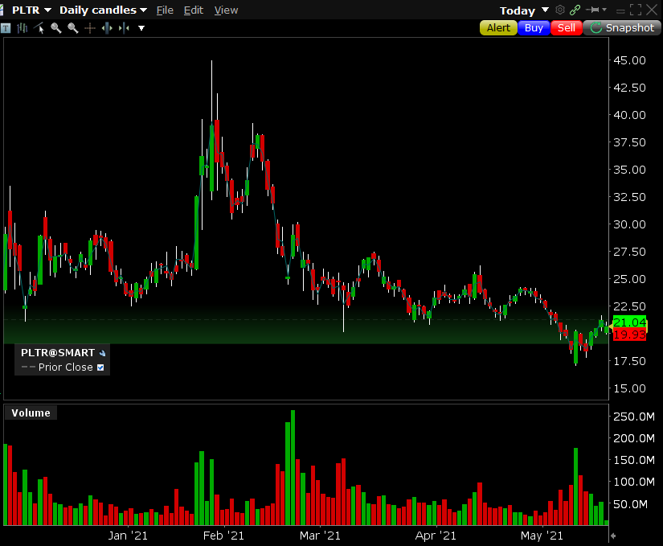
Bullish Risk Reversal: Example
It always starts with your hypothesis: You are bullish on the stock XYZ due to reason 1,2, and 3
Bullish Hypothesis

Slide 9
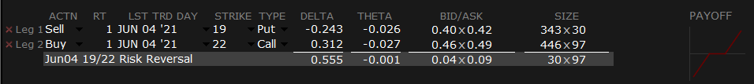
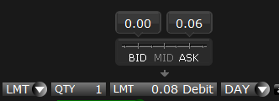
Bullish Risk Reversal: Example
PLTR is currently trading at $20.62
Sell $19, put for $0.41
Buy $22, call for $0.47
This is a debit transaction: $0.05 per contract
You are profiting from upside of PLTR with only spending $5 per 100 contracts rather than the $20.62 buying the underlying security

Slide 10
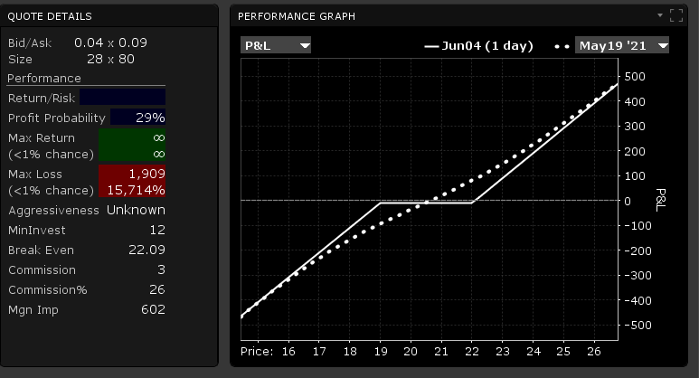
Bullish Risk Reversal: Example
Break even is at $22.09 which is the call strike ($22.00) plus the premium spent (0.09)
Max return is unlimited (on paper)
After your put strike + net premium spent, you lose dollar for dollar as the stock goes down

Slide 11
Bull Call Spreads
Buy 1 call, while simultaneously selling 1 call of the same expiry, but higher strikes
Reduce the premium
Capped upside
Payoff
X1
X2
Stock Price
Capped Downside

Slide 12
Bull Call Spreads
Max Loss | Net premium spent * 100
Max Upside | (Call spread width - premium spent) * 100
Breakeven | Lower strike + net premium spent

Slide 13
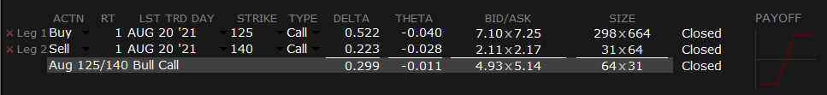
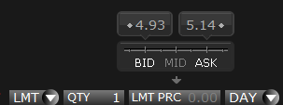
Bull Call Spread: Example
Hypothesis: Apple should go up over the next three months! We are currently in May, and my hypothesis is that the stock will close higher than what it is today
Apple Share price is $124.65
Buy Apple at $125 call (ITM or ATM)
Sell Apple call at $140
You pay $7.25 for the $125 calls and receive $2.11 for the $140 calls you sell net debit of $5.00

Slide 14
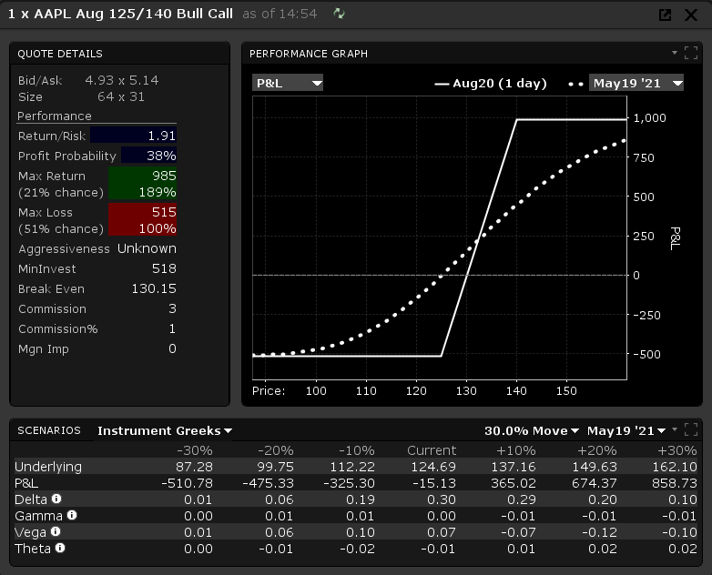
Bull Call Spread
Break even is at $130 which is the lower strike plus the premium spent
Return is capped at $1,000 = Spread width – premium *100
($140-$125-$5)*100
Understand what you are achieving with this strategy:
With $500 initial capital: you could buy 4 shares of Apple. If Apple hits $140, your profit will be $60

Slide 15
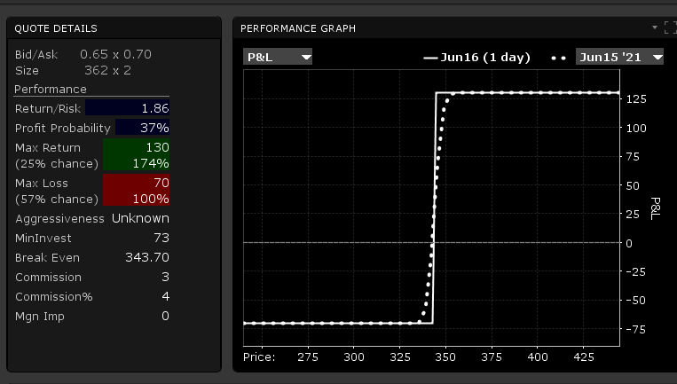
Setting up Spreads Throughout a Day
While I introduced spreads as a directional bets, many traders use this strategy throughout the day as a bet on low volatility
Imagine it is Wednesday June 16th and not much is going on in the market. $QQQ is trading at $342.35
You buy $343 call and sell the $345 calls to fund this transaction! Same day expiry (pm)

Slide 16
Bull Call Ladder
Like bull spread but you sell 2x OTM calls to fund your ATM call; hence the name ladder
Limited upside, unlimited lose
Ladder
Spread
Payoff
Payoff
Stock Price
Stock Price

Slide 17
Bull Ratio Spread
Buy a long call option and write a call option lower strike price, same expiry
You will buy more options than you write: choosing a specific ratio
The potential upside is not capped, and selling the calls helps fund the other call price
Ideal for take over targets and rumors, or a strong move up
You would lose more money if the stock does not move as much; hence it is a this or that strategy
Is the merger going through or not? Is the CEO changing? If you feel like we are at a tipping point, then this is the right strategy. If not, you could simply use bull call spread, or buying calls or other bullish strategies
This is also used as a hedge for a short position you might have
This would have been a good strategy for MEME stocks too!
Ideal timeline for these is 6 month to a year to get full advantage of time premium on option you would sell

Slide 18
Bull Ratio Spread
Payoff
You are worst off if the stock does not move as much! That is why, this is an amazing strategy for turnaround scenarios or M&A take overs
Up if net credit, down if net debit transaction
Stock Price

Slide 19
Bull Ratio Spread
Max Loss | (Long call strike – short call strike +/- net premium paid or received ) * 100
Max Upside | Unlimited
Breakeven Up | Nx long call strike – short strike call +/- net premium received or paid
Breakeven Down | Short strike call +/- net premium received or paid

Slide 20
Bull Ratio Spread (Example: Intel)
Imagine you believe that Intel is going to turn its company around
Management understands that NVDA and ARM deal would be a game changer and the company is losing market share
New chip design and manufacturing are great catalyst for the company to move around
Otherwise, the company will be eaten alive by NVDA and AMD, and the stock will fall further
Since it is a turnaround scenario, you form the bull ratio spread to take advantage of this situation
You sell the $42.50 calls for $13.40 per contract and buy 5 call contracts strike at $57.50 for $2.27 each, expiry in Sep 2021 after couple of earnings
Your net credit is $2.40 per spread

Slide 21
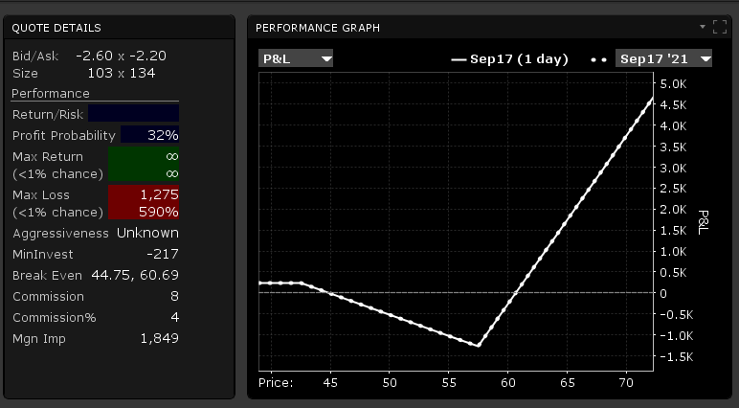
Short Bull Ratio Spread
Being able to maximize upside without putting down a huge amount of upfront money!

Slide 22
Bear Ratio Spread
The opposite of bull ratio spread
Buy a put option and sell a put option at higher strike price but same expiry
limited upside, limited downside
Ideal for shorting cult like stocks like Tesla or Palantir
Payoff
Stock Price

Slide 23
Bear Call Credit Spread
This a bearish bet: hypothesis is that the stock is going to go down in the near future
The way you set this up: Sell 1 call and simultaneously buy another at the same expiry, but higher strike
Capped Upside
Payoff
X1
X2
Stock Price
Capped Downside

Slide 24
Bear Call Credit Spread
Max Loss | (Call spread width -premium earned) *100
Max Upside | Premium earned *100
Breakeven | Lower strike + net premium spent

Slide 25
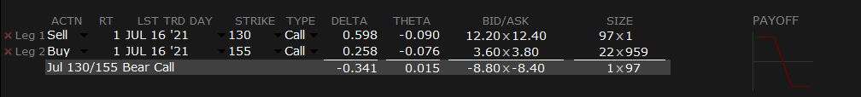
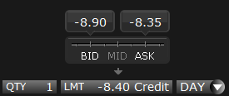
Bear Call Credit Spread: Example
You are building a hypothesis that AirBnb is over valued and estimate it should trade below $100
Sell Jul 16 $130 calls (ITM) (earn $12.30) and buy Jul 16 $155 calls (pay $3.80)

Slide 26
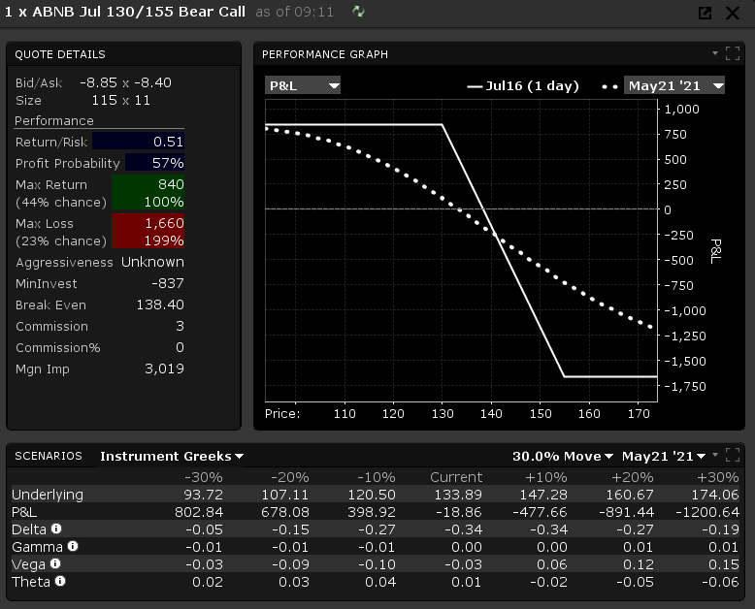
Bear Call Credit Spread: Example
Break even is at $138.40 which is the lower call strike, plus the premium spent ($130 +$8.40)
Return is capped at premium earned ($840)
Max loss: spread width ( $25 -8.40)*100 = -$1,660

Slide 27
Bet on Volatility
Following next few strategies are bets on volatility and not a specific direction.
However, for the sake of simplicity, we have bundled them in the directional section
Strategies are mostly used by market makers for hedging
When Investment banks or market makers write options for insinuations or hedge funds, they become short volatility
In order to hedge their positions, they open straddles to go long volatility
We must explain these strategies to lay the foundation for directional strategies

Slide 28
Long Straddle (Volatility Play)
This is the perfect strategy for a breakout or break down!
This is a bet on volatility
Hypothesis: The stock is going to move outside of a trading range: either up or down
You can produce this hypothesis using technical or fundamental approach
Buy one ATM call and buy ATM put same strike, same expiry date
Limited downside: Unlimited upside
Payoff
Unlimited Upside
Stock Price
Limited downside

Slide 29
Long Straddle
Max Loss | Premium spent *100
Max Upside | Unlimited
Breakeven Up | Call strike + total premium spent
Breakeven Down | Put strike - premium spent

Slide 30
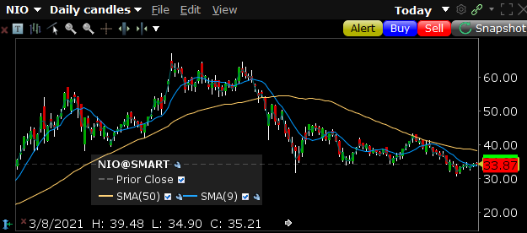
Long Straddle: Example
NIO has been trading in a range: about to breakout or breakdown prior to the earnings

Slide 31
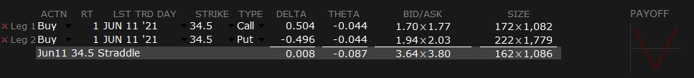
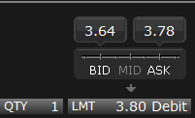
Long Straddle: Example
Buy one ATM June 11 call strike $34.50 Buy ATM put June 11 strike $34.50
Call cost $1.76 Put costs $2.02 Total debit $3.80

Slide 32
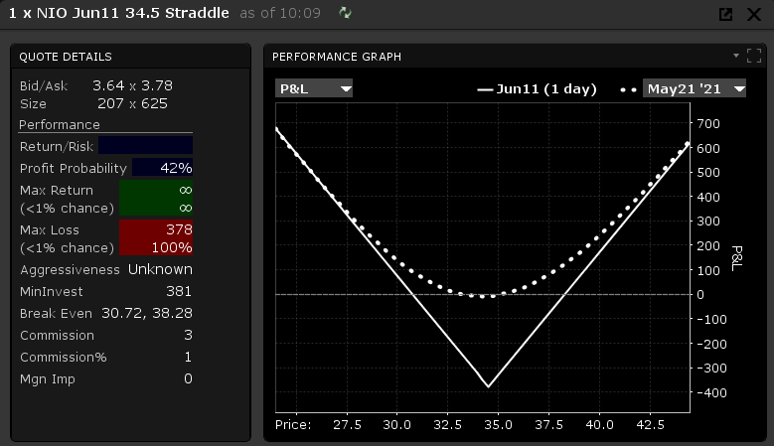
Long Straddle: Example
Break even is at strike +- the premium spent
Return is unlimited
Maximizing both side move: must pay close attention to implied volatility to make sure the move is reasonable
Remember you are trading volatility in Straddle

Slide 33
Strap Straddle (Directional Move: Bullish)
This move is like the straddle with more emphasis on one direction than another
Instead of buying 1x ATM call and 1x ATM put option, you use 2x or 4x ATM call options
Now the focus is on the direction rather than bet on volatility
If you are long 3 calls vs. 1 put: it is said you have a 1-3 hedge
You are increasing your payoff while still hedging the downside
Payoff
Stock Price

Slide 34
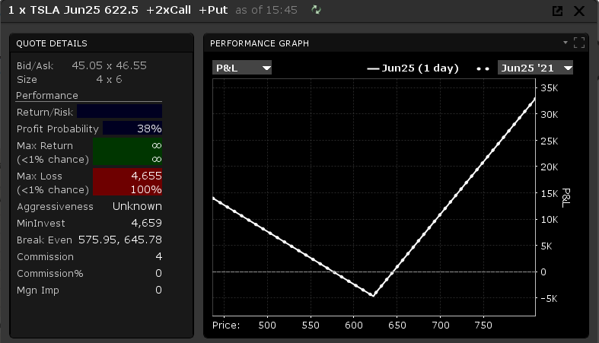
Why Not Just Use A Simple Call?
Let’s look at it in two ways: Your bet is correct, and the stock goes up or goes down.
If the stock goes down, you lose less than a long call, or sometimes make money
If your bet is correct and the stock goes up, you are making slightly less than just a call
This is the trade off you do here to hedge the downside

Slide 35
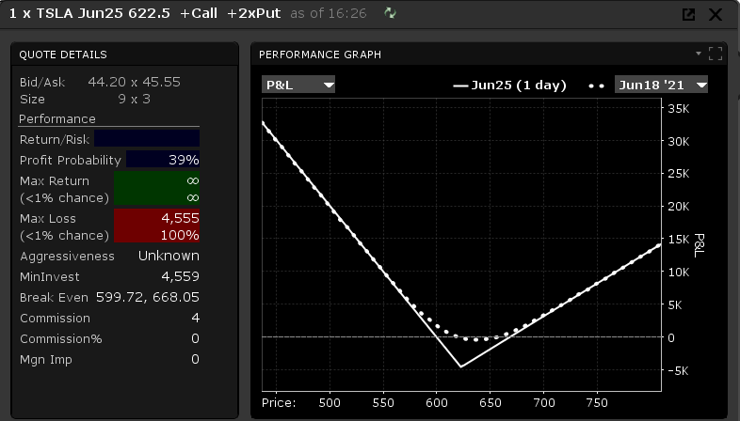
Strip Straddle (Directional Move: Bearish)
This is similar to the strap straddle, but it is a bearish bet
Rather than buying calls, this time you are going overweight on the puts.
You make less here but lose less here as well.

Slide 36
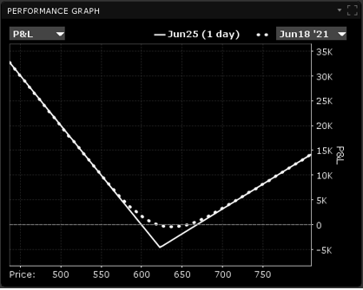
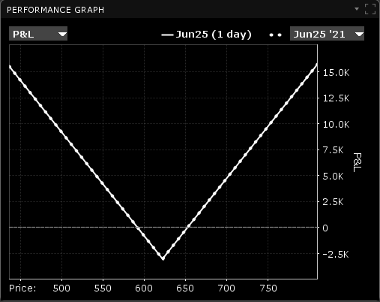
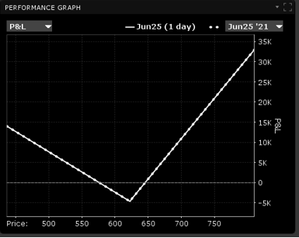
Straddles side by side
Strip Straddle (Bearish)
Straddle (Long Volatility)
Strap Straddle (Bullish)
Bearish bet
Protect downside
Limit upside gain
Gain would be less than puts alone or short stock
Bet on volatility
No direction
Harder to make money since the market makers price in implied volatility
Bullish bet
Protect downside
Limit upside gain
Gain would be less than long call or long stock

Slide 37
Long Strangle
Strategy for a drastic swing!
The way you make this is by buying 1 OTM put and 1 OTM call, same expiry, different strikes
Limited downside and unlimited upside!
Unlimited upside
Payoff
Premium Paid
X1
X2
Stock Price

Slide 38
Long Strangle
Max Loss | Premium spent *100
Max Upside | Unlimited
Breakeven Up | Call strike + total premium spent
Breakeven Down | Put strike - premium spent

Slide 39
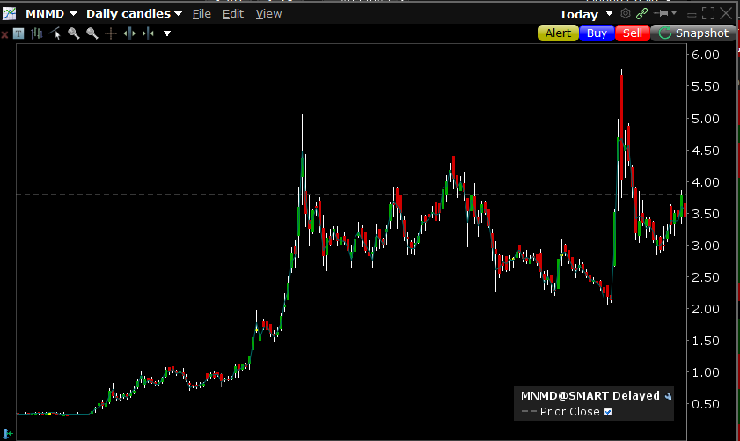
Long Strangle: Example
Mind Med $MNMD is releasing their result from their clinical trials of MDMA
The stock will either shoot up or sell off to previous lows. Big announcement.

Slide 40

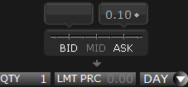
Long Strangle: Example
Buy OTM call for September strike at $5 Buy OTM puts strike $2.5 same expiry
Expecting a massive move; hence you need high volatility
Pay 0.05 for the call. Pay 0.05 for the puts: Total costs: $0.10

Slide 41

Conclusion
We reviewed many useful strategies to take advantage of trends in the markets:
Risk Reversal
Spreads
Straddle
Strangle
Ladders
Ratios

