Slide 1
Using Options as a Range Strategy

Slide 2
Course Outline
Option basics
Class 1
Using options for Income generating strategies
Class 2
Class 3
Using options Option as a hedging strategies
Using options for directional bets
Class 4
Using options for range bets
Class 5
Using options for day trading (by Andrew and Jarad)
Class 6
Option psychology and idea generations
Class 7

Slide 3
Class Objective
To understand options : pricing, risk, and returns (review)
To use option as reliable strategies for making profit during consolidation or when market is trading in a range
Understanding risks and payout diagrams
To understand Butterfly, Short Straddle, Short Strangle, and Iron Condor

Slide 4
Strategies Discussed in this Class
Range Strategies
Butterfly
Short Straddle
Short Strangle
Iron Condor

Slide 5
When to Use Range Bound Strategies
These strategies are ideal for when the overall volatility is low in the market
Would work great on low Beta securities: i.e., stocks that move less compared to the overall market.
These strategies would work better on indexes and E.T.F’s which are tracking a basket of stocks rather than one security.
Daily movement and ATR of E.T.F’s is far less than individual stocks, which makes them ideal for range bound strategies.

Slide 6
Stock Phases and Options
Stock Price
These strategies are perfect for these stage
Distribution Phase
IPO Price: $30
Market Up Phase
Market Down Phase
Bull Call Spread
Accumulation Phase
Bullish Risk Reversal
Bear Call Spread
Put
Short Straddle
Long Call Butterfly
Iron Condor
Time

Slide 7
Butterfly Strategy
Great strategy with a fixed risk and capped profit
Pays the most if the market is not moving as much!
The strategy is simple: Sell 2 ATM calls and buy one ITM call and one OTM call to form the wings for same expiry
Payoff
Stock Price

Slide 8
Butterfly
Max Loss | Premium spent
Max Upside | (ATM call strike price – ITM call strike price – total debit paid)*100
Breakeven Up | OTM call strike price - total debit paid
Breakeven Down | ATM call strike price + total debit paid

Slide 9
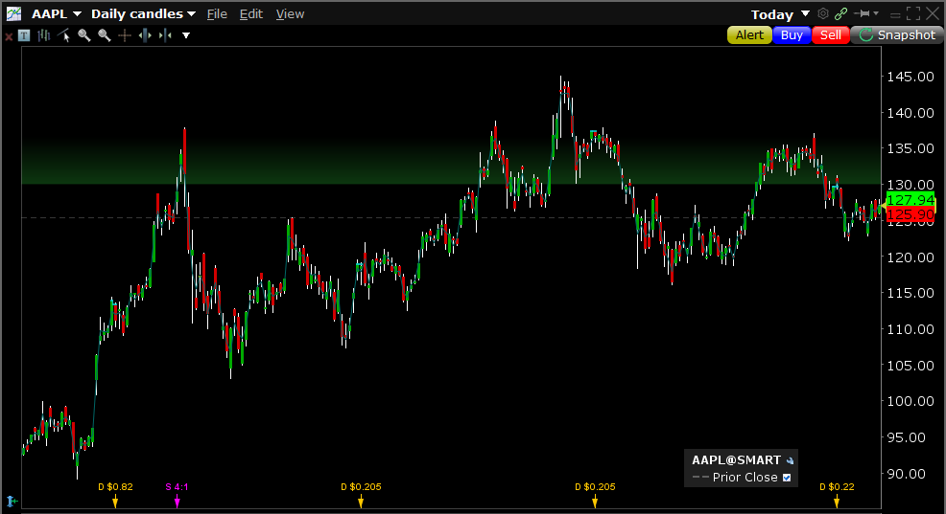
Butterfly Strategy: Example
Apple has been trading in a range! No upside or downside catalyst to help the stock break out
Your Hypothesis: The stock will continue to trade in a range!
Apple current price: $128 on May 24th
Apple trading in a range bound
Apple will be around $130 over the next few month

Slide 10
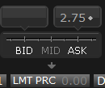
Butterfly Example
Sell 2 calls ATM : $130 expiry for August 2021 (earn $10.20)
Buy 1 $120 (ITM) call for $10.90
Buy 1 $140 (OTM) call for $2.00
Net debit cost of $2.75 i.e., $275 per I contract of this strategy

Slide 11
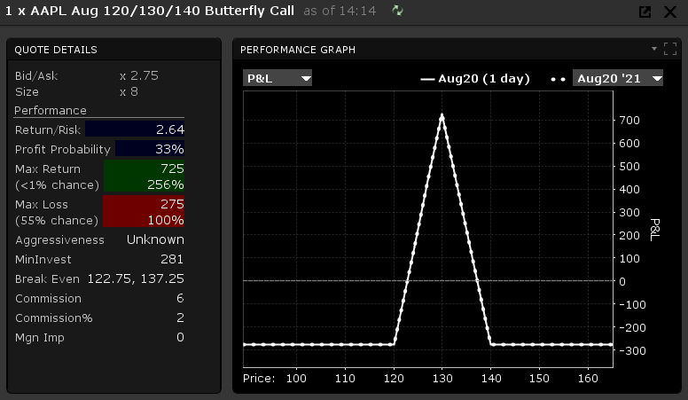
Butterfly Example
This strategy is ideal for the time were VIX is low and volatility in the market is minimal
Max loss is your premium spent
These strategies usually have negative Vega, meaning work bests when the volatility is low

Slide 12
Short Straddle
Unlimited risk and capped profit (not an ideal strategy)
Traders may run this strategy to take advantage of a possible decrease in implied volatility
The strategy is simple: Sell 1 ATM call and sell one 1 ATM put for same expiry
Payoff
Stock Price
You have unlimited downside, which is not ideal, in any strategy

Slide 13
Short Straddle
Max Loss | Unlimited
Max Upside | Total premium collected
Breakeven Up | Put strike price + total premium collected
Breakeven Down | Call strike price - total premium collected

Slide 14
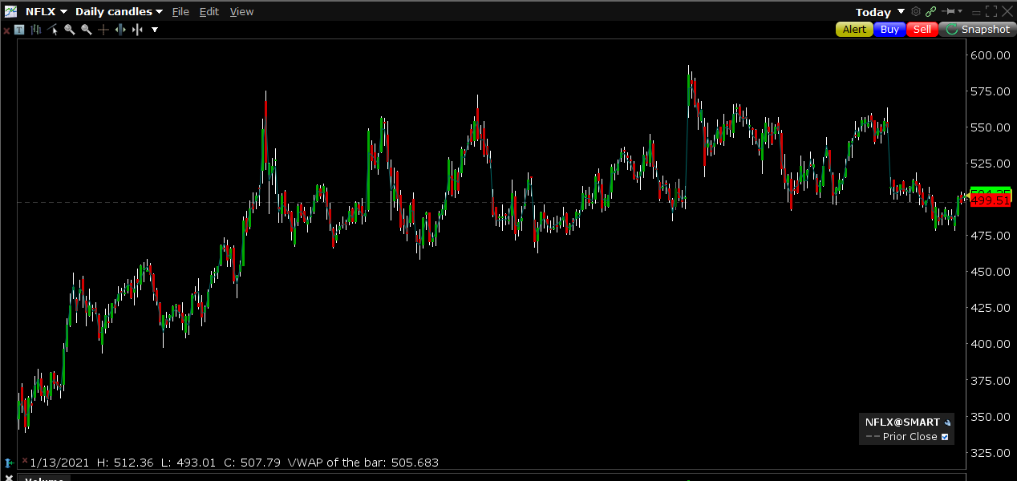
Short Straddle Example
Netflix has been trading between $480 and $580 in the last 12 months
Netflix is currently trading at $500 on May 24th, 2021
You want to take advantage of this range and make money
Hypothesis: Netflix will be around $520 at the expiry

Slide 15
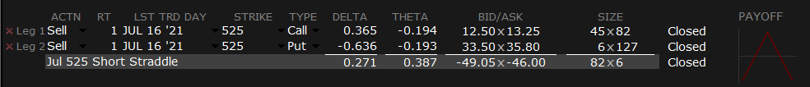
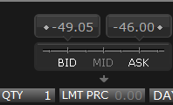
Short Straddle: Example
Hypothesis: NFLX is trading in a range of between $480 - $580. We would like to collect premium by selling calls and puts
Sell $525 call for $12.88
Sell $525 put for $34.65
Total premium collected: $47.53 per contract

Slide 16
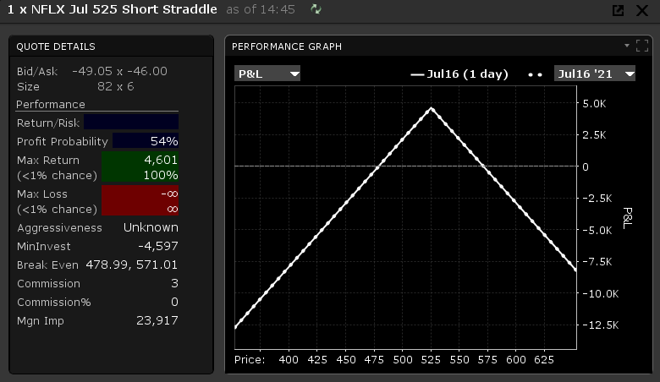
Short Straddle Example
Breakeven is at strike +/- the premium spent
Max Loss is unlimited
This strategy is reverse of straddle and hence you do not want large amount of volatility in the market or your specific security
Ideal for your low beta securities

Slide 17
Short Strangle
Unlimited risk and capped profit
Pays the most if the market is not moving as much!
The strategy is simple: Sell 1 OTM put and sell 1 OTM call for same expiry
Payoff
Stock Price
You have unlimited downside, which is not ideal, in any strategy

Slide 18
Short Strangle
Max Loss | Unlimited
Max Upside | Total premium collected
Breakeven Up | OTM call strike price + total premium collected
Breakeven Down | OTM put strike – total premium collected

Slide 19
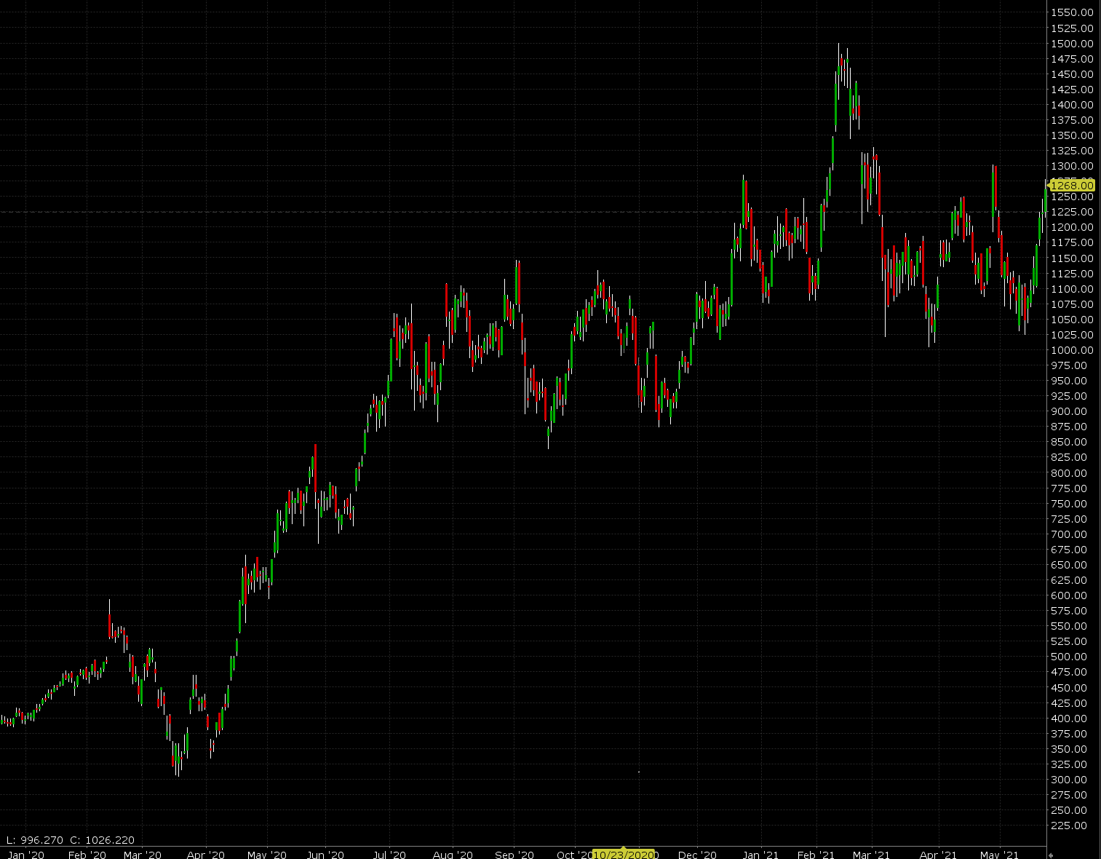
Short Strangle Example
Shopify $SHOP is trading at $1,262, on May 24, 2021.
Shopify has been trading between $1,025and $1,325
You want to take advantage of this range and make money
You may want to consider choosing the strike price to be 1 standard deviation away from current price

Slide 20
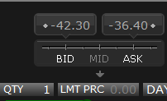
Short Strangle Example
Hypothesis: Shopify is trading within the range of $1,025 and $1,325. We expect Shopify to trade around $1,165 to $1,312.5 at expiration and collect the premium
Sell 1 OTM put $1165 for $13.05
Sell 1 OTM call for $26.30
Total premium collected is $39.35 per contract

Slide 21
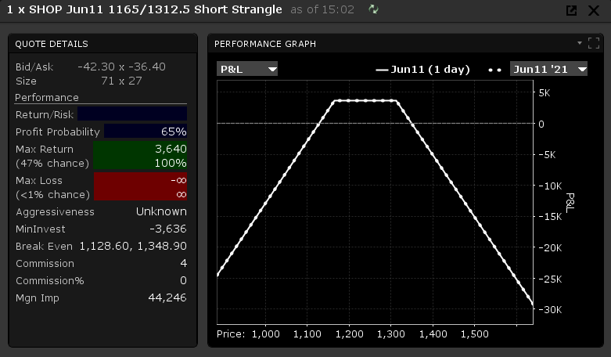
Short Strangle Example
Breakeven is at $1,165 minus the total premium collected and $1,312.5 plus total premium collected
Maximum loss is unlimited
Maximizing profit is the total premium collected $39.35 *100

Slide 22
Iron Condor
Great strategy with a fixed risk and capped profit
Pays the most if the market is not moving as much!
The strategy is simple: Buy 1 OTM put (A), sell 1 OTM put (B), sell 1 OTM call (C), and buy 1 OTM call (D) with the same expiry
Payoff
A
B
C
D
Stock Price
Stock price

Slide 23
Iron Condor Vs Strangle
These two strategies are basically the same, except you are protecting your downside in the condor, for a small price.
Iron Condor
Short Strangle
Pay Off
Payoff
Stock Price
Stock Price

Slide 24
Iron Condor
Max Loss | (Strike B – strike A – total premium collected)* 100
Max Upside | Total premium collected
Breakeven Up | Strike C + total premium collected
Breakeven Down | Strike B – total premium collected

Slide 25
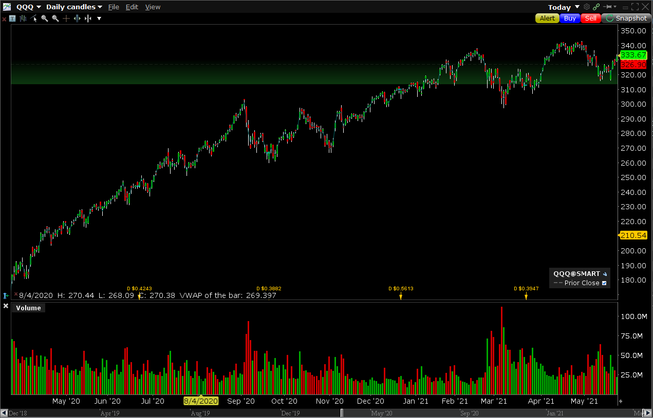
Iron Condor Example
QQQ is currently trading at $331 on May 24th , 2021
QQQ is trading in a range of between $300 and $340
You want to take advantage of the range
Hypothesis: QQQ will be in a range of between $311 and $340

Slide 26
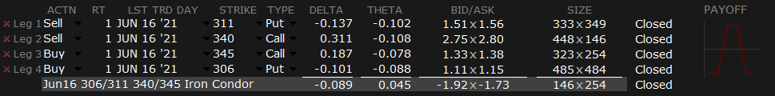
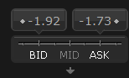
Iron Condor: Example
Hypothesis: QQQ is trading in a range of between $300 - $340
Buy 1 OTM put strike at $306 for $1.13
Buy 1 OTM call at $345 for $1.36
Sell 1 OTM put at $311 for $1.53
Sell 1 OTM call at $340 for $2.77
Total premium collected is $4.22 and total debit is $2.49 per contract; hence a net credit of $1.73 per contract

Slide 27
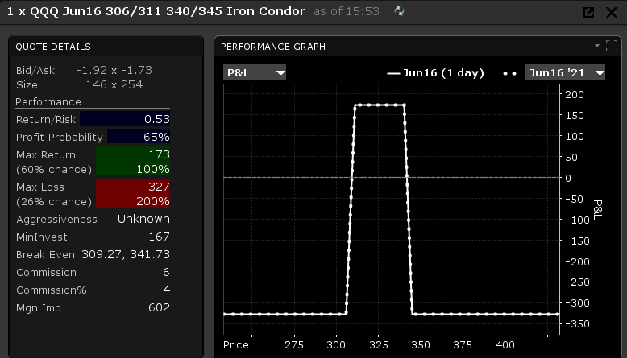
Iron Condor: Example
Breakeven is at $311 minus the total premium collected and $340 plus total premium collected
Maximum loss is $311 - $306 – total premium collected
Maximizing profit is the total premium collected $4.22 – $ 2.49: $1.73

Slide 28

Conclusion
We reviewed many useful strategies to take advantage of low volatility in the markets:
Butterfly
Short Straddle
Short Strangle
Iron Condor

