Slide 1
Option Psychology and Idea Generation

Slide 2
Course Outline
Option basics
Class 1
Using options for Income generating strategies
Class 2
Class 3
Using options Option as a hedging strategies
Using options for directional bets
Class 4
Using options for range bets
Class 5
Using options for day trading (by Andrew and Jarad)
Class 6
Option psychology and idea generations
Class 7

Slide 3
Class Objective
To learn how to use the option framework for decision making
How to generate ideas for your trades
How to conduct cost and benefit analysis
How to conduct sensitivity analysis
Putting the option framework to practice: two live case studies, Apple and Blue Apron

Slide 4
How to generate ideas?
By far, one of the most important session in the whole series: Option framework will be introduced here
In this session, we will be discussing some of the best practices on generating ideas and option strategies
We will introduce the concept of risk to reward and marginal benefits
The key in being a successful option trader: knowing when to use what strategies
When: This is based on your thesis: Bullish, Bearish, or Neutral
What: This is based on the concept of marginal benefit, which is what strategy can provide the highest yield for you in this scenario

Slide 5


Forming a Thesis
There are three major thesis you could have based on your analysis
Bearish
Neutral
Bullish

Slide 6

Forming a Thesis
You could get to this idea using variety of methods: fundamental, technical, and macro
Technical: moving averages, trends, RSI, MACDs
Fundamental: expected earning growth, increased TAM, potential patent approval
Macro: reopening play, green energy, rising interest rate environment

Slide 7
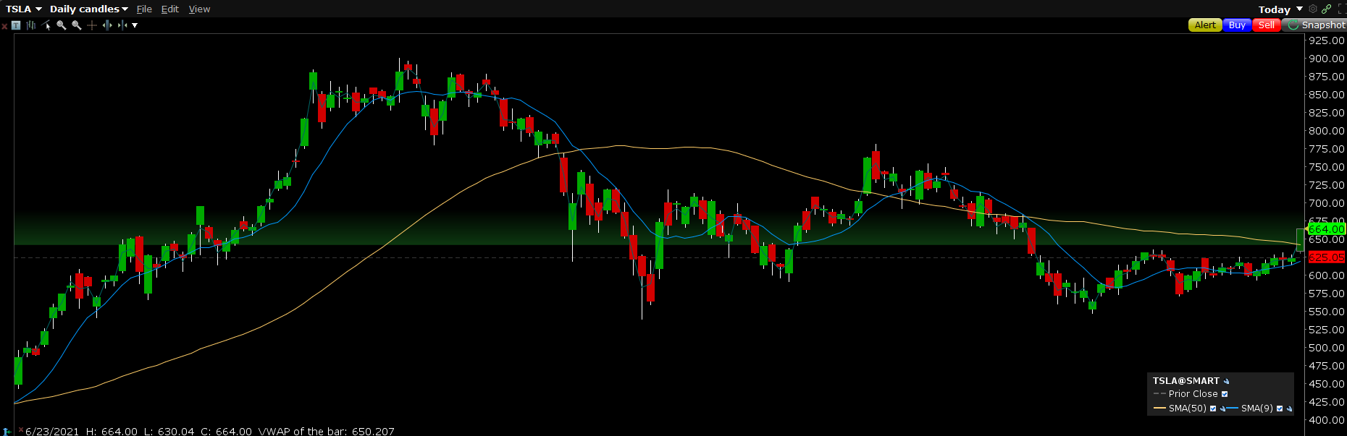
Technical
Moving average cross over: How lower can it go?
Breakout: How much higher can it go?
What is the next resistance level?

Slide 8
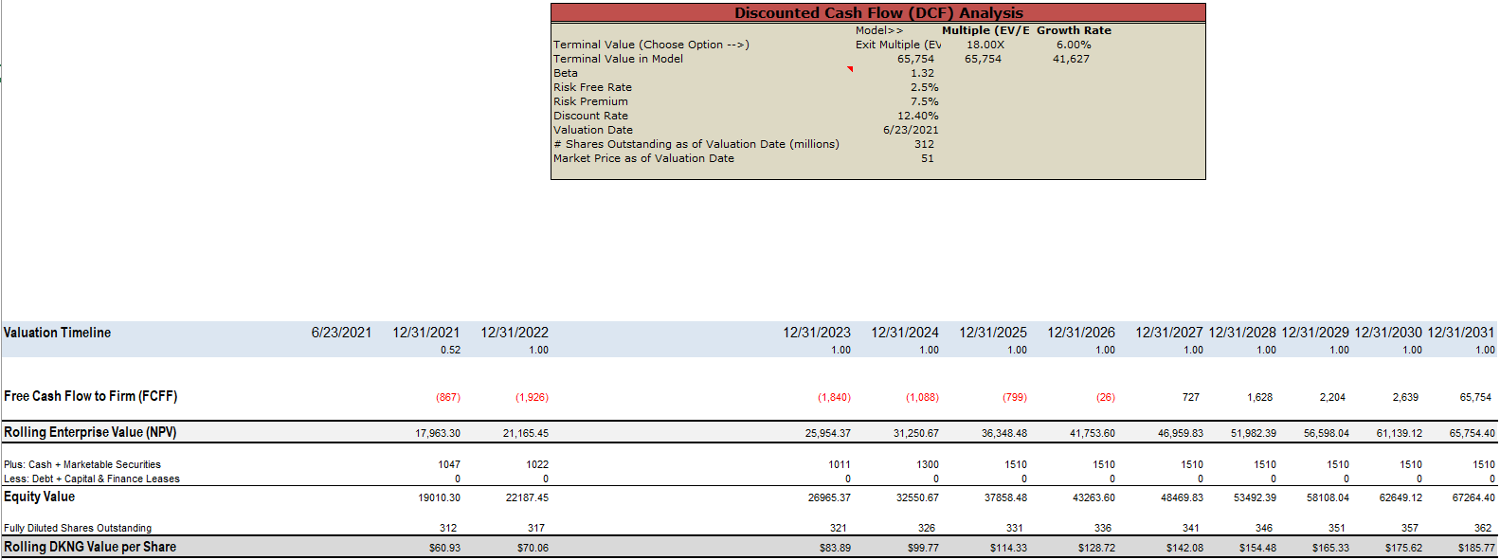
Fundamental
DCF, quantitative, factor-based models mixed with a catalyst
Forecasting cashflows and producing price targets: What is the ceiling, how high, or how low can it go? Placing a trade based on that

Slide 9
Macro
Fear of inflation
Cash now is better than cash in the future
Higher dividend stocks and energy & material
Rising rate environment
More interest income for banks
Bank stocks with commercial and residential focus

Slide 10
Option Framework
Fundamental analysis
Can options help us magnify those return and give us an edge?
Technical analysis
Macro thesis

Slide 11
Qualifying Questions
These qualifying questions will help you choose the right strategy
What is the sentiment? Are we bullish, bearish or solely focusing on volatility?
What is the expected move? 10% or 20% to the next resistance level? Breakout?
What strategy yields the highest return? What are the cheapest to set up and highest return?
How does sensitivity and scenario analysis look like? What if the implied volatility or the rate changes?
Pick the right strategy and execute!

Slide 12


Option framework
Form your thesis based on your technical, fundamental, or macro analysis: Bullish, Bearish, or Market neutral
Use the accompanied pdf and choose few ideal strategies
Conduct the marginal benefit analysis and find out what strategy provides the highest return at the lowest set up cost
Use the accompanied Excel file for sensitivity analysis with different implied volatilities
Execute and monitor closely for results

Slide 13
Case Study: Apple
Apple has been hovering around $130. Currently at $133, the stock finally breaks out and the next resistance level is $140 (you have identified your sentiment as bullish)
Note how you have used the technical framework for your decision making
Apple is expected to move from $130 to $140 ➔ This is an 8% move up
You could use the following strategies: Simply buying a call, buying a call spread, risk reversal, or ladder
Here is where you must do a cost benefit analysis and produce the right strategy
What is max return, max loss, in each strategy? Can I produce this strategy with going net credit instead of debit?

Slide 14
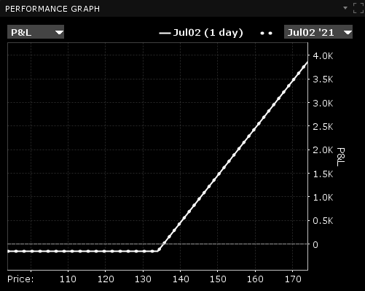
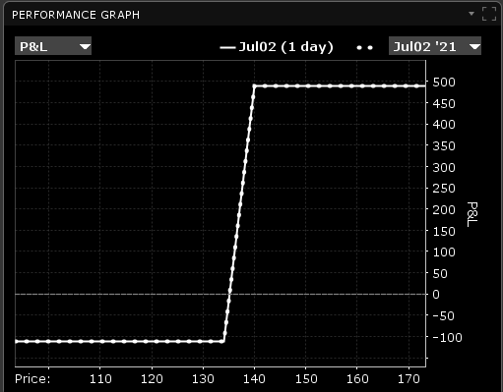
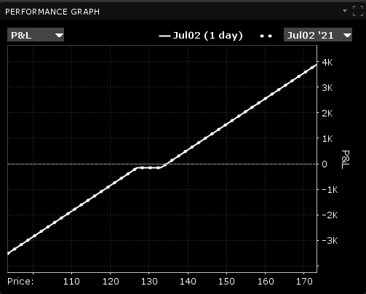
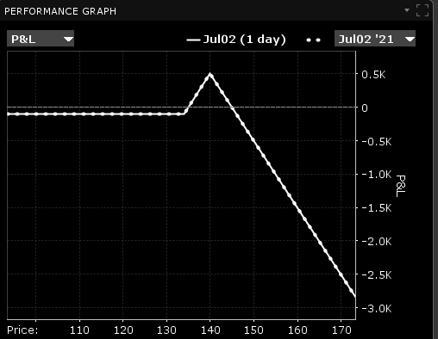



Case Study: Apple
Call
Spread
Risk reversal
Ladder
Price: $1.53
Cost per contract: $153
Potential upside: $500
Risk to reward: 1:3
Price: $1.10
Cost per contract: $110
Potential upside: $500
Risk to reward: 1:5
Price: $1.50
Cost per contract: $150
Potential upside: $560
Risk to reward: NA
Price: $1.00
Cost per contract: $100
Potential upside: $500
Risk to reward: NA

Slide 15
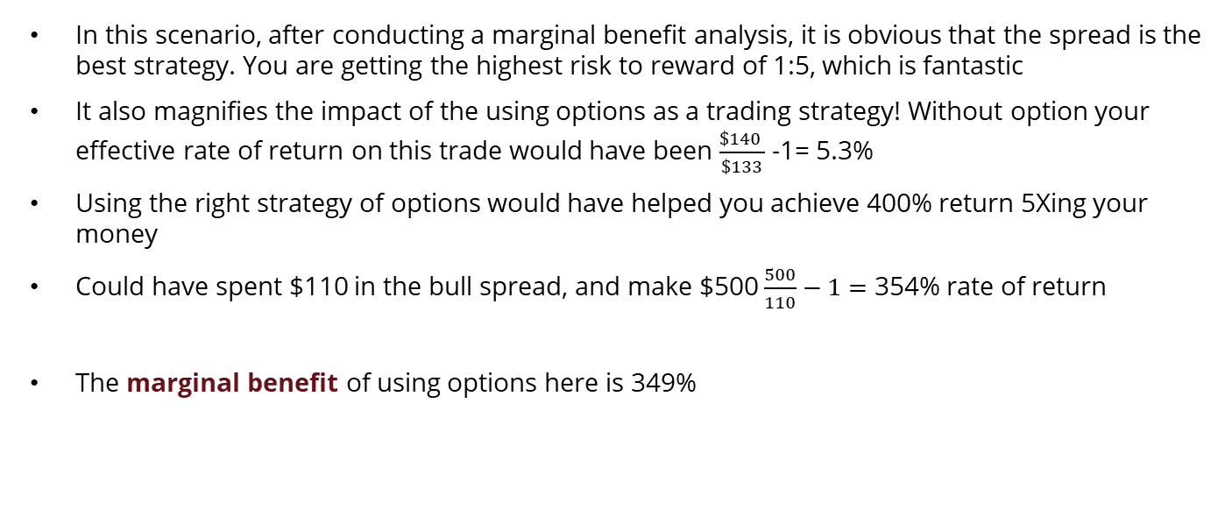
Case Study: Apple
In this scenario, after conducting a marginal benefit analysis, it is obvious that the spread is the best strategy. You are getting the highest risk to reward of 1:5, which is fantastic
It also magnifies the impact of the using options as a trading strategy! Without option your effective rate of return on this trade would have been $\frac{\$140 }{\$133}$ -1= 5.3%
Using the right strategy of options would have helped you achieve 400% return 5Xing your money
Could have spent $110 in the bull spread, and make $500 $\frac{500}{110}−1=$ 354% rate of return
The marginal benefit of using options here is 349%

Slide 16
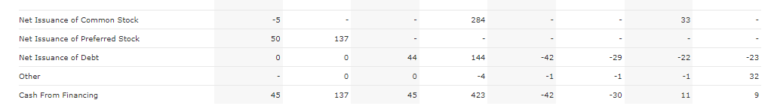
Case Study: Blue Apron
APRN has been struggling. The company has not been able to turn in profit. Sales has been growing YoY, but no margin expansion has been achieved.
The company hence needs to raise additional shares periodically, becoming a shareholder’s dilution machine!
New management has come on board and believes can turn around the company.
Note that you are using fundamental analysis to produce your thesis
The company either will go to zero or turn it around and will be worth $12- $14 by the year end

Slide 17
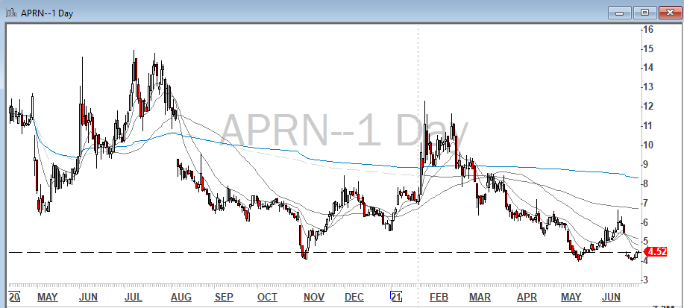
Case Study: Blue Apron
This has shown itself in the stock chart as well:
What are your options? Buy the underlying stock and hope for the best? Buy a call option, do a straddle or a bullish ratio spread
Your timeline for this turnaround is 6 to 8 months. You look at the options with expiry in 200 days

Slide 18
Case Study: Blue Apron
Stock
Call
Straddle
Ratio Spread
Price: $4.50
Risk: $450
Potential upside: $950 if it goes to $14
Risk to reward: 1:2
Price: $1.35
Cost per contract: $135
Potential upside: $900
Risk to reward: 1:8
Price: $3.00
Cost per contract: $300
Potential upside: $700
Risk to reward: 1:3
Price: $0.80
Cost per contract: $80
Potential upside: $900
Sell call at $3 to fund two call at $5: ratio is 1:2
Risk to reward: 1:11
Payoff
Payoff
Payoff
Payoff
$900
Stock Price
Stock Price
Stock Price
Stock Price
$4.50
$5.00
$5.00
$14.0
$6.35
$15
$5.00
$2.95
$6.35
$1.20
$6.35

Slide 19
Case Study: Blue Apron
After conducting a marginal benefit analysis, it is obvious that the best strategy here is the ratio spread with the ratio of 1:2
In this case, you are putting down less money and are participating in the upside, dollar for dollar
You are also profiting in case the turnaround plan failed and the companies stock moved lower
This is an example of using the framework we provided for performing the marginal benefit analysis, to get the best results.

Slide 20
Option framework
Form your thesis based on your technical, fundamental, or macro analysis: Bullish, Bearish, or Market neutral
Use the accompanied pdf and choose few ideal strategies
Conduct the marginal benefit analysis and find out what strategy provides the highest return at the lowest set up cost
Use the accompanied Excel file for sensitivity analysis with different implied volatilities
Execute and monitor closely for results

Slide 21
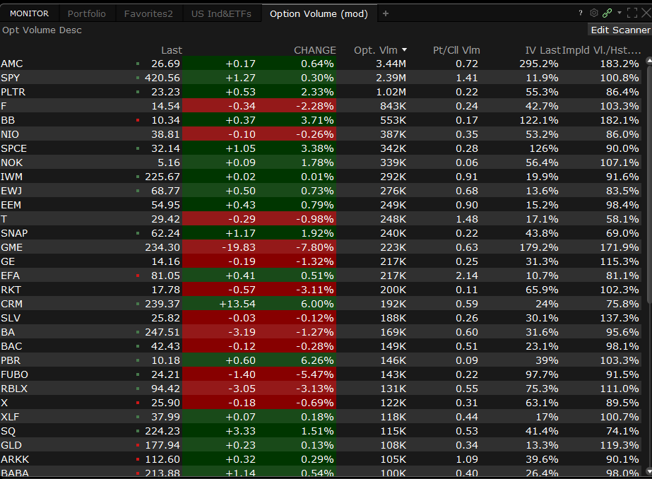
Other tools: Scanners
There are scanners that show the most active options for that day. Sometimes you can use these information in forming thesis or get a better temperature check on the market and its direction
One of my favorite scanners are via IB’s TWS which shows you IV, and IV/HV

Slide 22
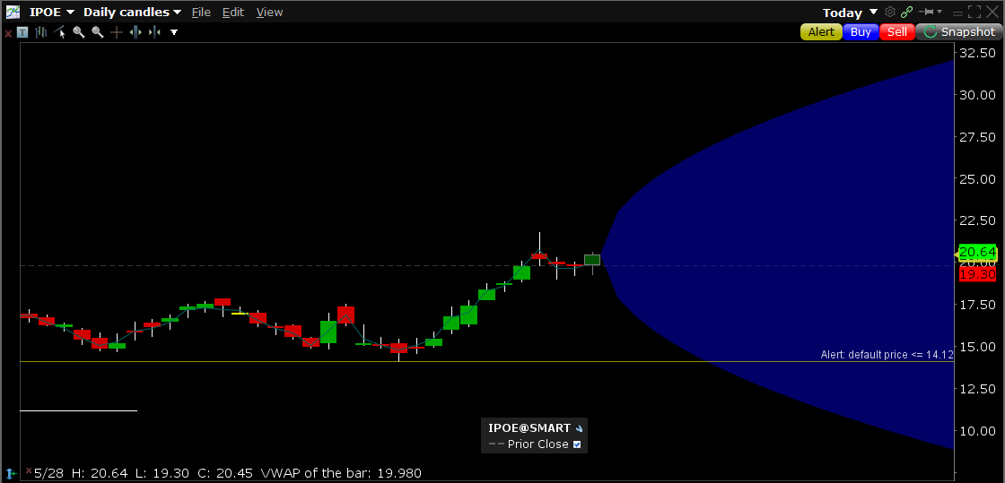
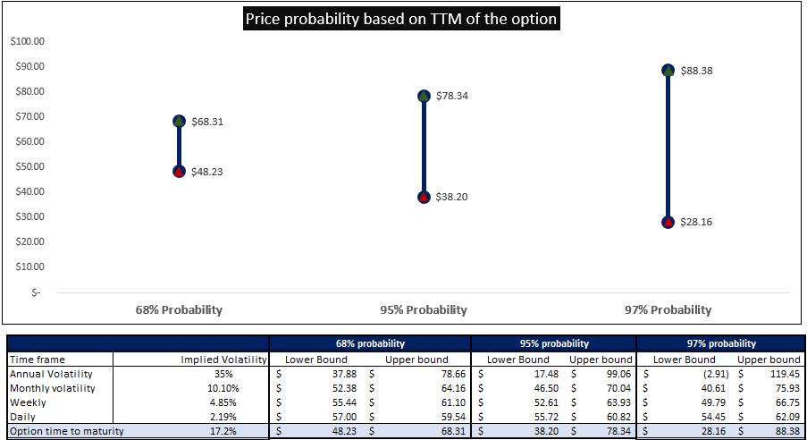
Other useful tools: Volatility and Probability
You can use implied volatility and statistical principles to get a range of the price and predict whether your option will be in the money or not. Interactive Broker TWS and other platforms provide this for you.
Our Excel template also does this for you and is a simple plug and play based on the maturity of your option .
Interactive Broker
BBT Template

