Slide 1
Implied Volatility Demystified
Ardi Aaziznia

Slide 3
Agenda
What is Implied Volatility
Realized volatility V.S. implied volatility
How does IV dictates your strategy.
Short Strangles
Condors
Diagonal Spreads

Slide 4
The Third Dimension
Stocks
Options
Long
Short
Long
Speed
Short

Slide 5
What is Volatility?
We talk a lot about volatility, “oh market is volatile”
Today is a “volatile day”
On CNBC “Volatility is elevated”
But what is Volatility?
Any guesses?

Slide 6
Volatility
Volatility
Majority of today’s session will be on this
Realized volatility
Implied volatility

Slide 7
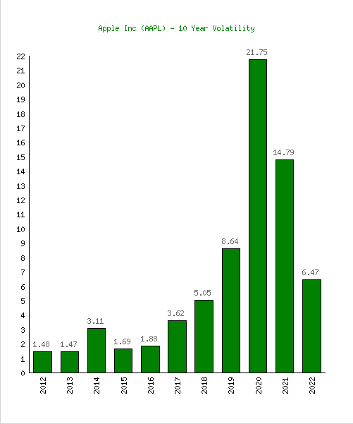
Realized Volatility
Standard deviation of price returns

Slide 8
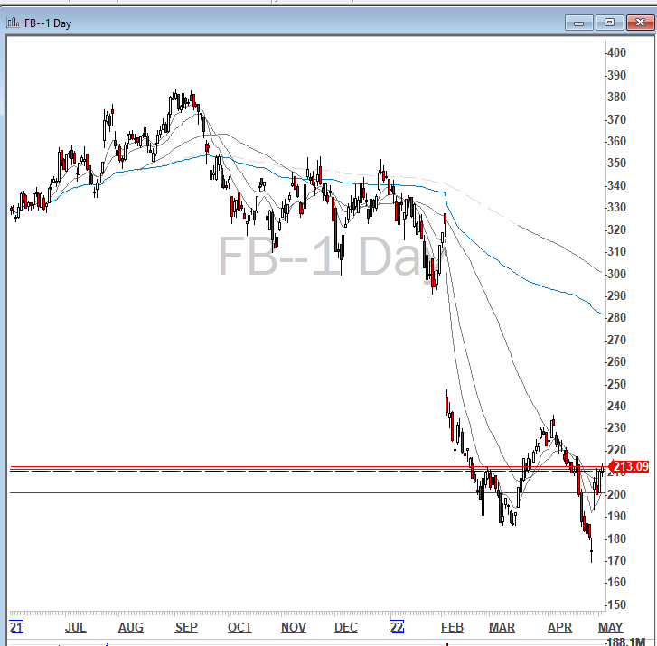
Realized Volatility
Realized volatility is focusing on what has happened in the past.
The deviation of the returns from the mean.
But we care more about future.
Can we guess where the stock is going?

Slide 9
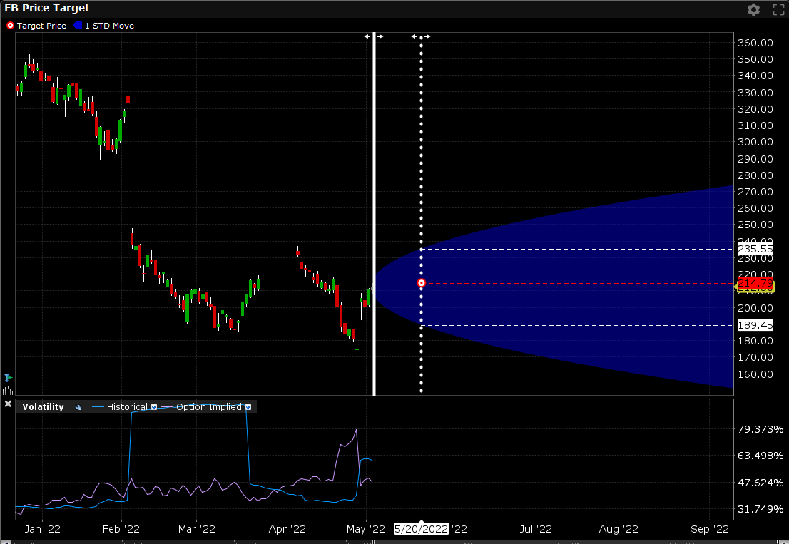
We Can Have a Very Strong Guess
There is a 70% chance that FB will be between $189 and $235 May 20th 2022
How is IB estimating this range?
Is this Magic?

Slide 10
Introducing: Implied Volatility
How the price movement is going to be in the future
Implied volatility unit is usually in annual format
Derives from the option market.
Is it an input or output of the Black Scholes Model?

Slide 11
Implied Volatility
Expected Volatility | Formula
Monthly | $\frac{Annual volatility}{\sqrt{12}}$
Weekly | $$\frac{Annual volatility}{\sqrt{52}}$$
Daily | $$\frac{Annual volatility}{\sqrt{252}}$$

Slide 12
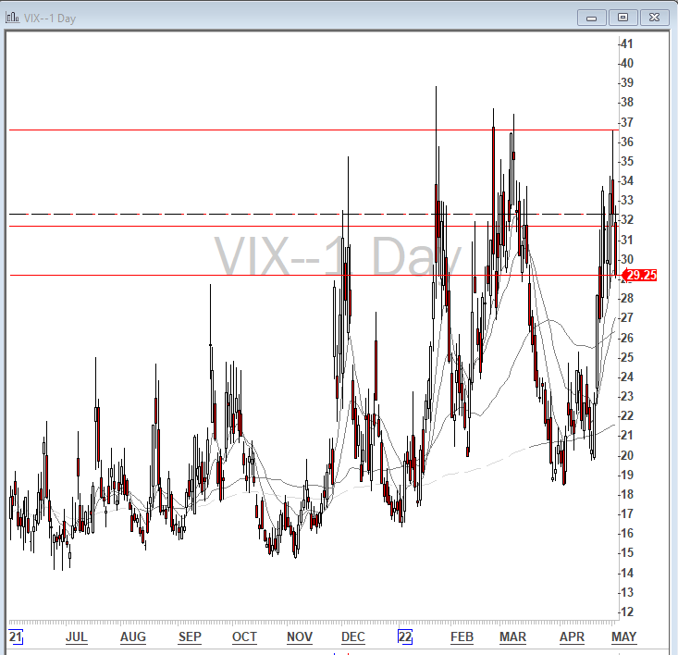
VIX: 30 Day Implied Volatility
What can VIX tell us?

Slide 13
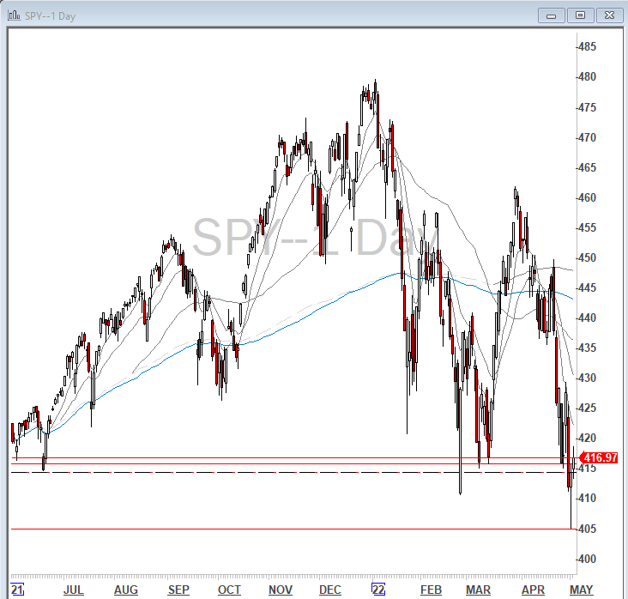
What Can VIX Tell Us?
$451
$382

Slide 14
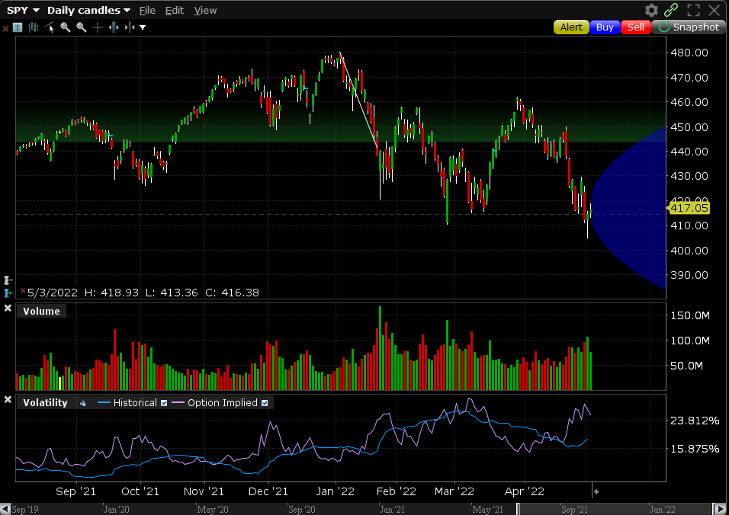
Let’s Check with IB

Slide 15
Implied Volatility
In summary: Implied volatility is the out put of the option pricing model.
It is your guide and compass of how the stock is going to move.
It is the third dimension of option trading which is: SPEED.
Understanding implied volatility dictates your strategy.
Do we want to short volatility?
Do we want to go long volatility?

Slide 16
VIX and Volatility Regimes
Lower than 15
15-20
Debit calls
Condors, short strangles
Market trends during this time. Usually upward, ideal to pay for premium
Stable Vol, it is amazing for running range bound plays.
20-25
Higher than 25
Credit
Panic Mode
Early panic mode environment. Using credit spreads usually helps in the scenarios like this.
Go long volatility. If you are not hedged, make sure to hedge your downside during uptick, sell premium if you guess bottom is close

Slide 17
Short Strangles
Selling OTM Call and OTM put
The goal is to short volatility
Identifying a range
Very profitable strategy
Risk management is important
Payoff
Stock Price
You have unlimited downside, risk management is important

Slide 18
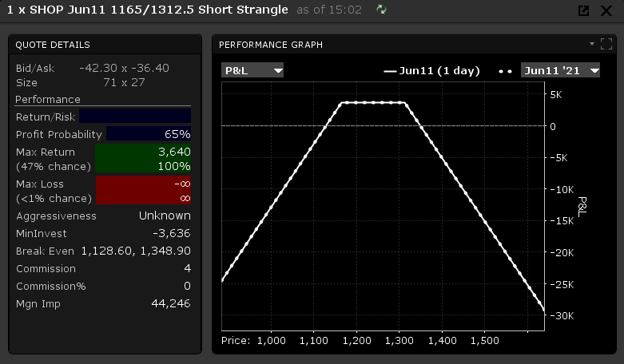
Payoff Diagram

Slide 19
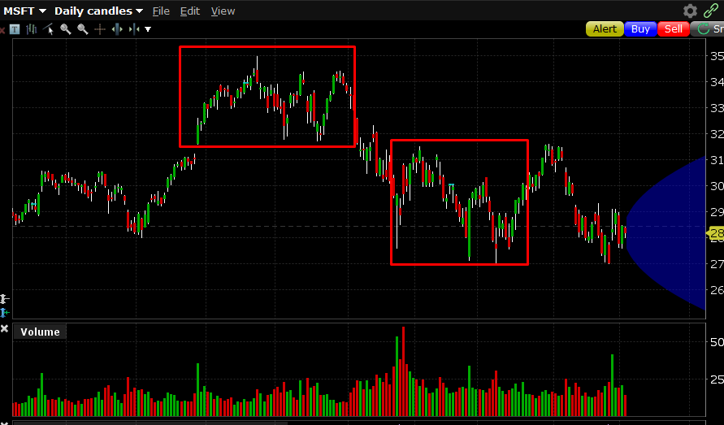
Short Strangles

Slide 20
Short Strangle
Is VIX below 20
Is implied volatility stable
Is the term structure normal: i.e no earnings or major events?
Risk management is in place?
Is margin requirement and excess liquidity in place?

Slide 21
Iron Condor
Great strategy with a fixed risk and capped profit
Pays the most if the market is not moving as much!
The strategy is simple: Buy 1 OTM put (A), sell 1 OTM put (B), sell 1 OTM call (C), and buy 1 OTM call (D) with the same expiry
Payoff
A
B
C
D
Stock Price
Stock price

Slide 22
Iron Condor Vs Strangle
These two strategies are basically the same, except you are protecting your downside in the condor, for a small price.
Iron Condor
Short Strangle
Pay Off
Payoff
Stock Price
Stock Price

Slide 23
Iron Condor
Max Loss | (Strike B – strike A – total premium collected)* 100
Max Upside | Total premium collected
Breakeven Up | Strike C + total premium collected
Breakeven Down | Strike B – total premium collected

Slide 24
Iron Condor
Is VIX below 20
Is implied volatility stable
Is the term structure normal: i.e no earnings or major events?
Risk management is in place?
Are you aware of 1/3 rule? Do you have an exit plan?

Slide 25
Calendar Spread
These are called diagonal strategies
Does anybody know why they are called diagonal?
Calendar call spreads
Put diagonal spreads

Slide 26
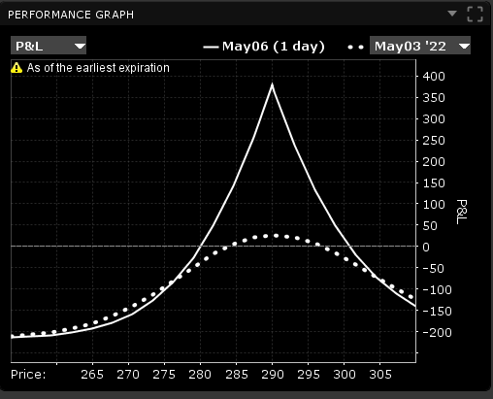
Calendar Call Spread
Sell a OTM call: front end expiry
Buy a OTM call (same strike): backend expiry
Looking for low IV, but hoping IV will increase on the backend
The IV increase and delta increase of the backend, will offset the negative delta on the front end.

Slide 27
Calendar Call Spread: IV

Slide 28
Calendar Spread
Is VIX below 20
Has Implied volatility imploded
Is the term structure normal: i.e no earnings or major events?
Risk management is in place?

Slide 29
Let’s Wrap Up
What is Implied Volatility
What are characteristic of volatility
How does IV dictates your strategy.
Short Strangles
Condors
Diagonal Spreads

Slide 30
Ardi@bearbulltraders.com
Ardi_Aaziznia

