Slide 1
TradeBook: Getting Started
Mike B.

Slide 2
DISCLAIMER

Slide 3
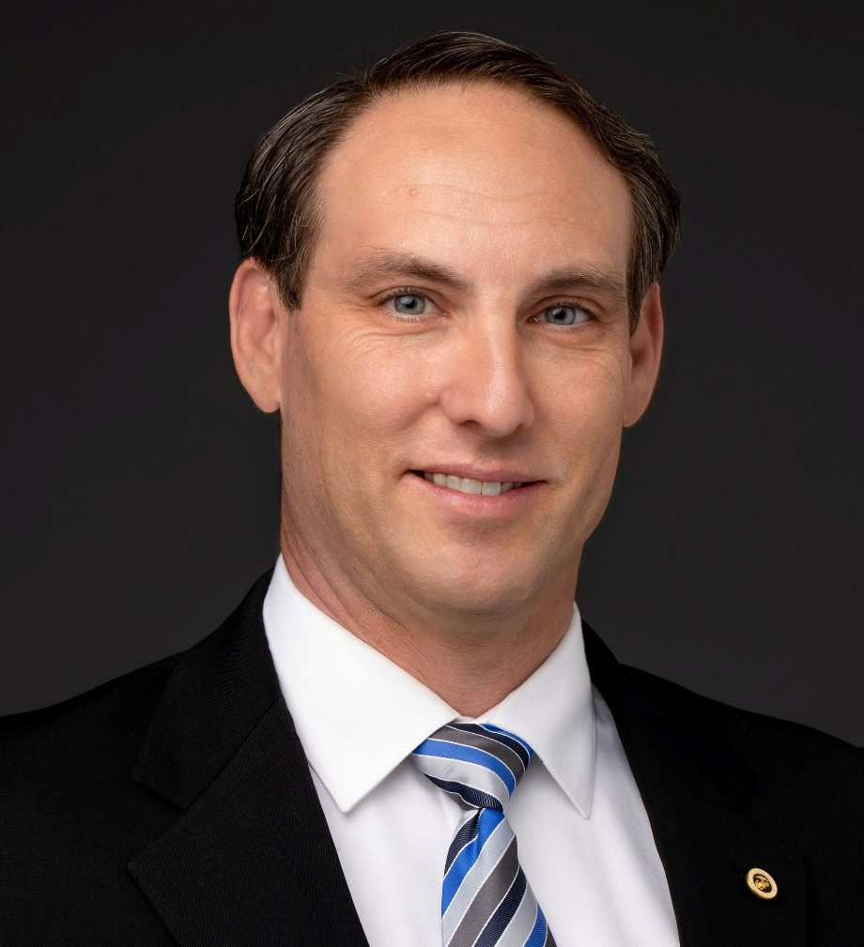
Mike Baehr
History Prior to Trading:
Trading History:
Trading Strategies:
Hobbies:

Slide 4
Overview

Slide 6
mike@peakcapitaltrading.com

